Slide 1
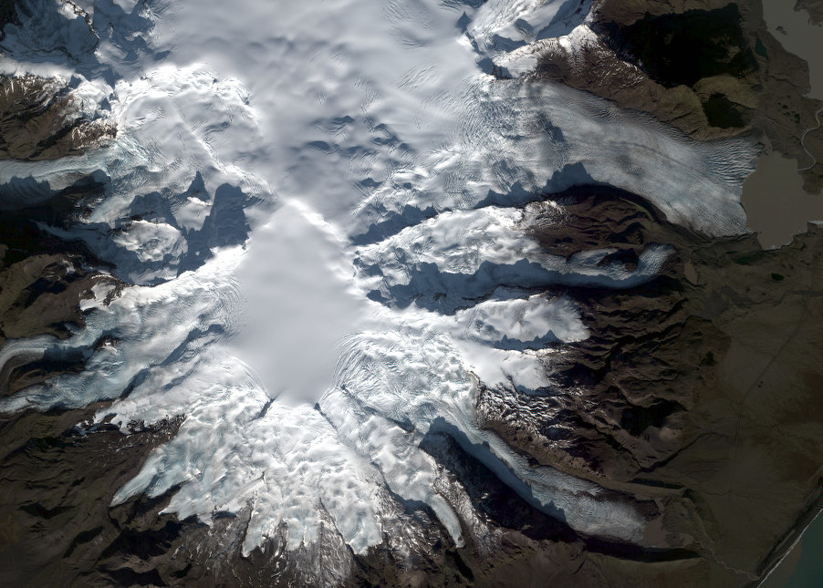
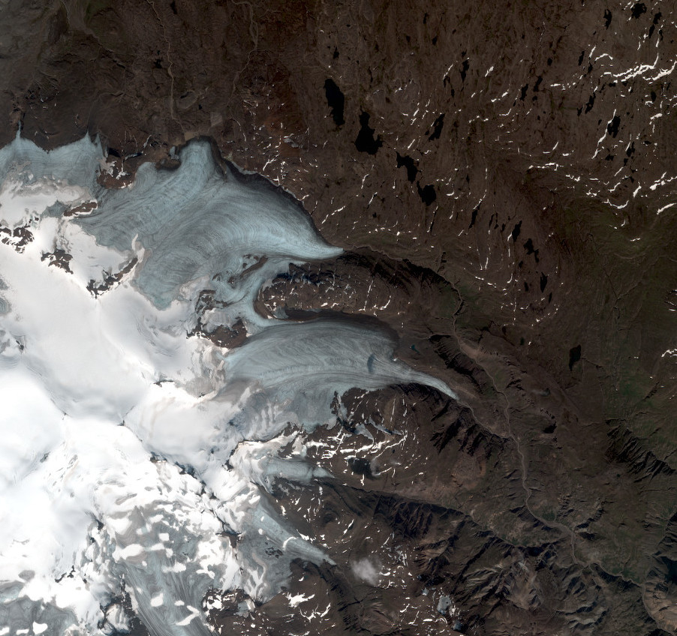
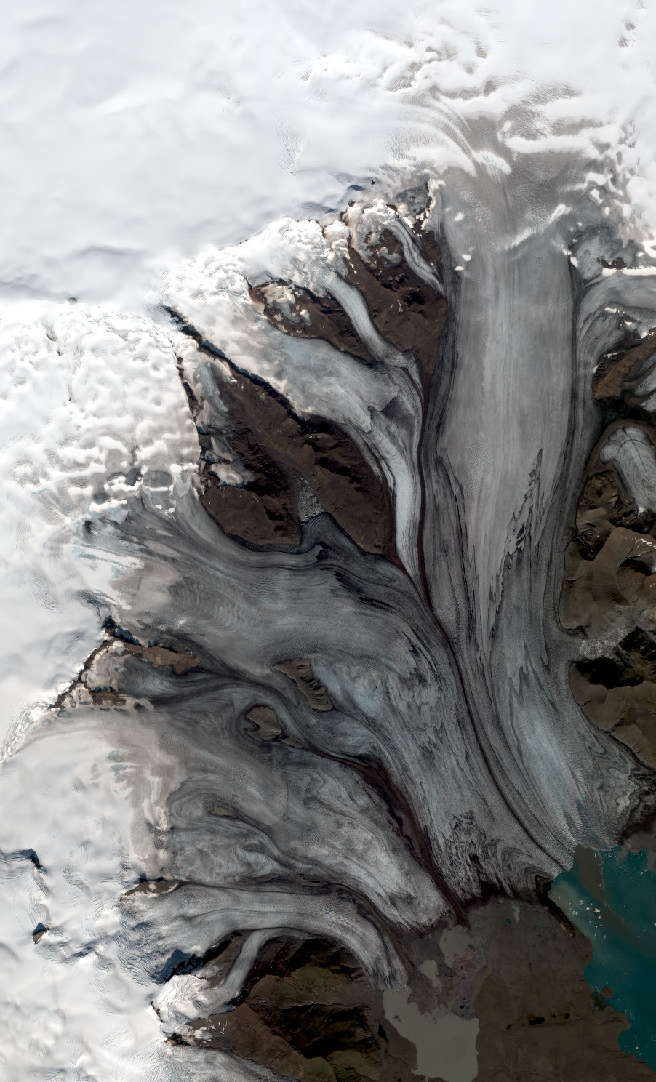
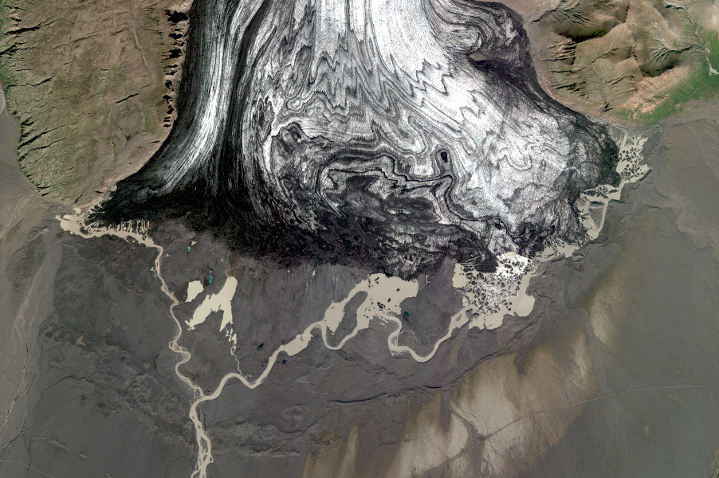
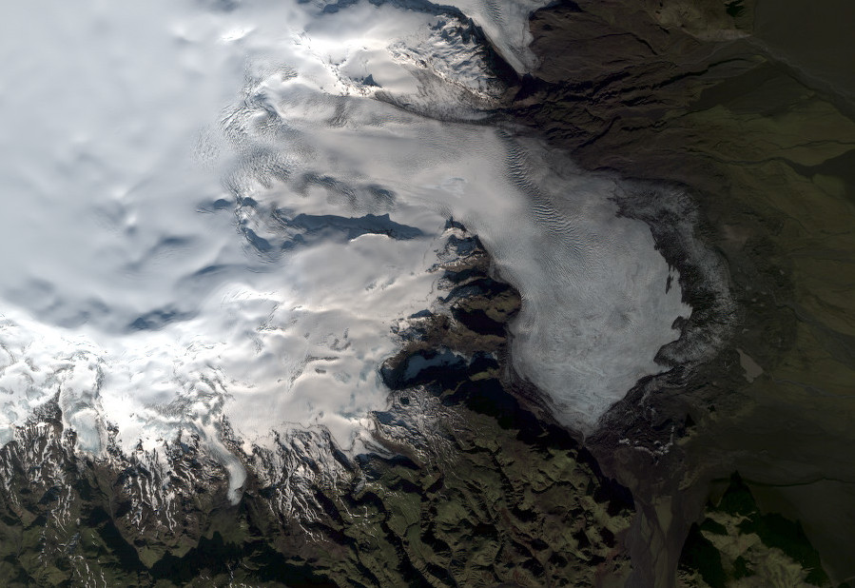
Pléiades & SPOT7 surveys 2021

Slide 2
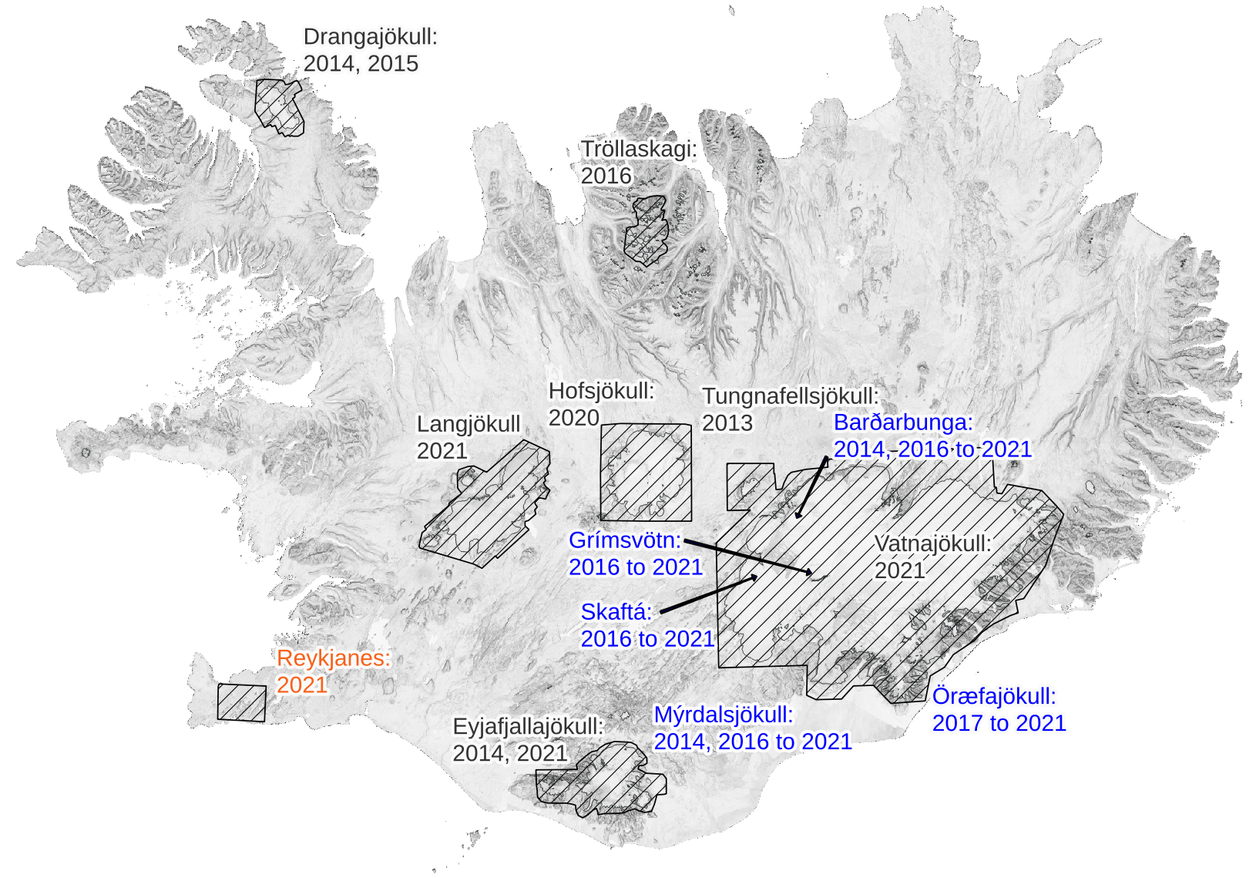











Pléiades & SPOT6/7 surveys 2013-2021
Main mapping initiatives:
CIEST² Initiative
Dinamis & Geosud
CEOS-Volcano Supersite

Slide 3
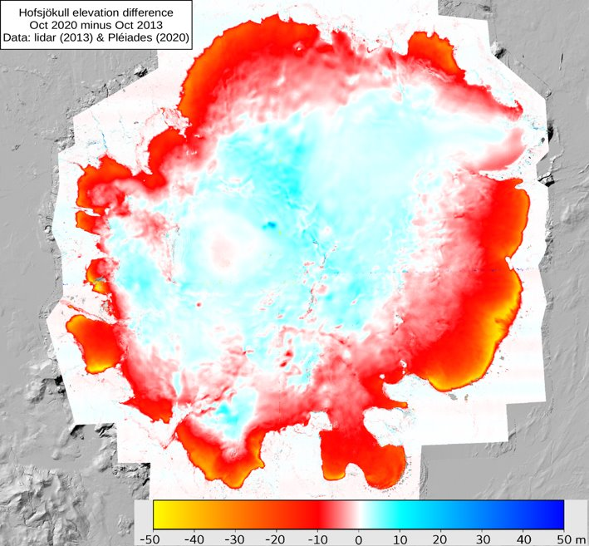
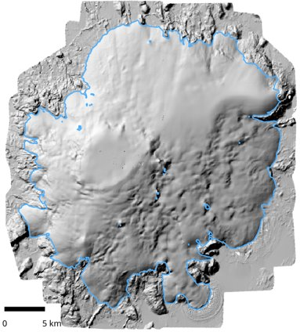
Hofsjökull: Pléiades 2020
Hofsjökull Pléiades 2020 surveys:
August: 14th, 16th
October: 1st, 2nd, 5th

Slide 4
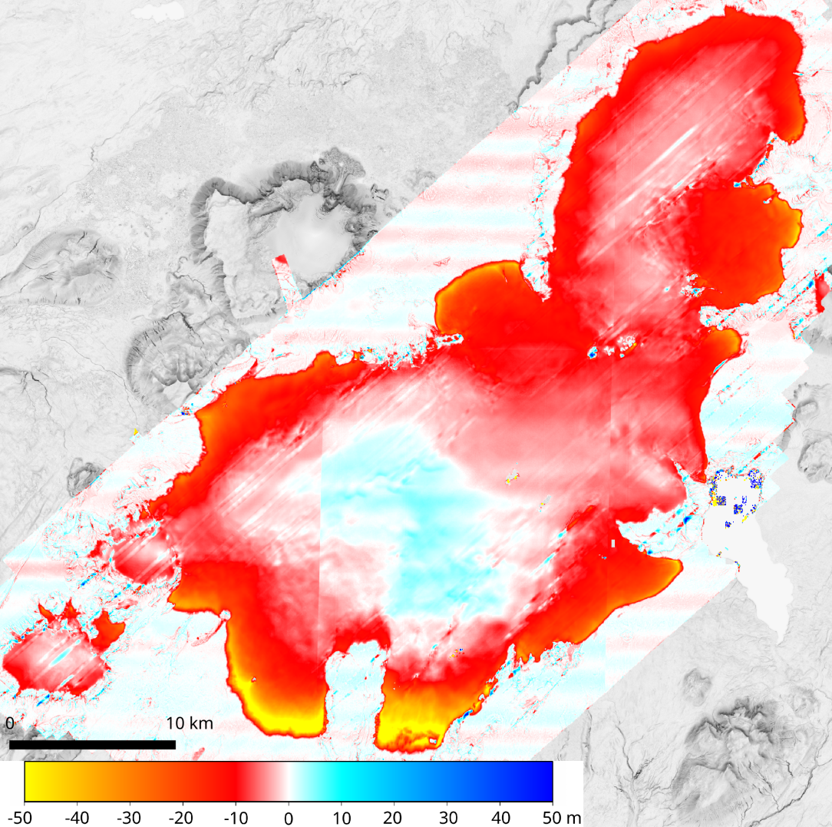
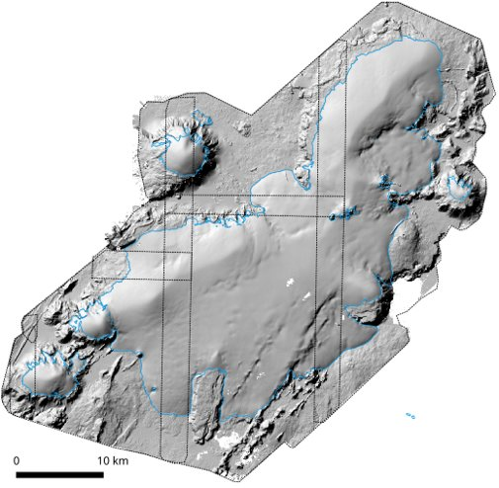
Langjökull: Pléiades 2021
Langjökull Pléiades 2021 surveys:
September: 9th
October: 6th, 11th

Slide 5
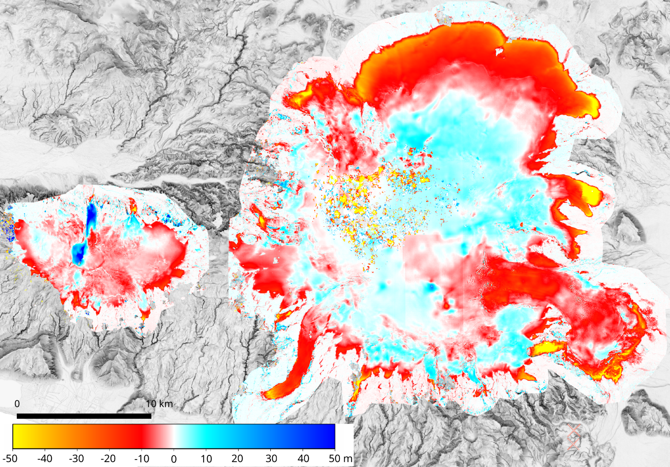
Mýrdalsjökull & Eyjafjallajökull: Pléiades 2021
Pléiades 2014 surveys:
August 11th & 19th
Pléiades 2021 surveys:
September 9th
October 14th, 20th
November 2nd

Slide 6
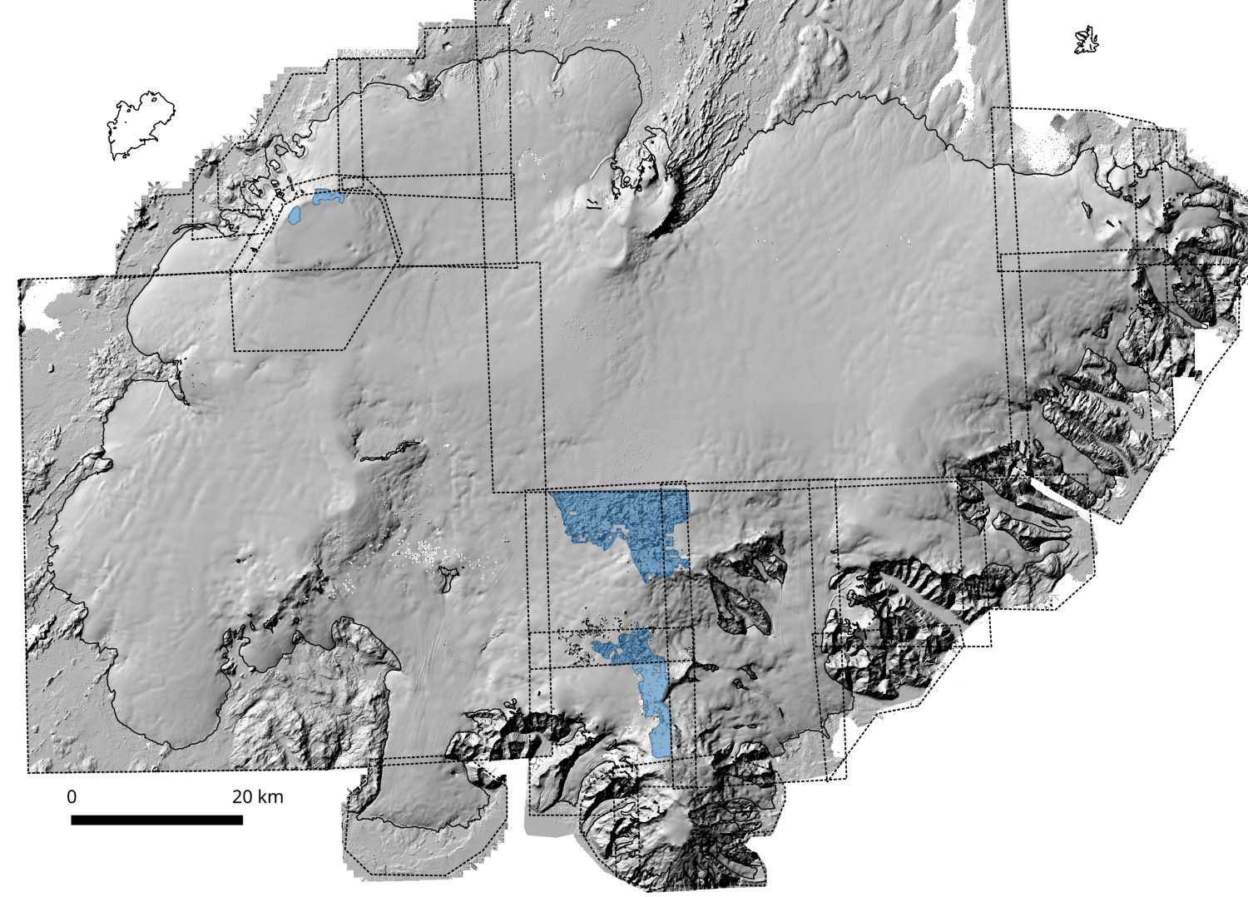
Vatnajökull: SPOT7 & Pléiades 2021
24 stereopairs acquired between 16th of August and 7th of November
98% of Vatnajökull covered (gaps due to clouds)

Slide 7
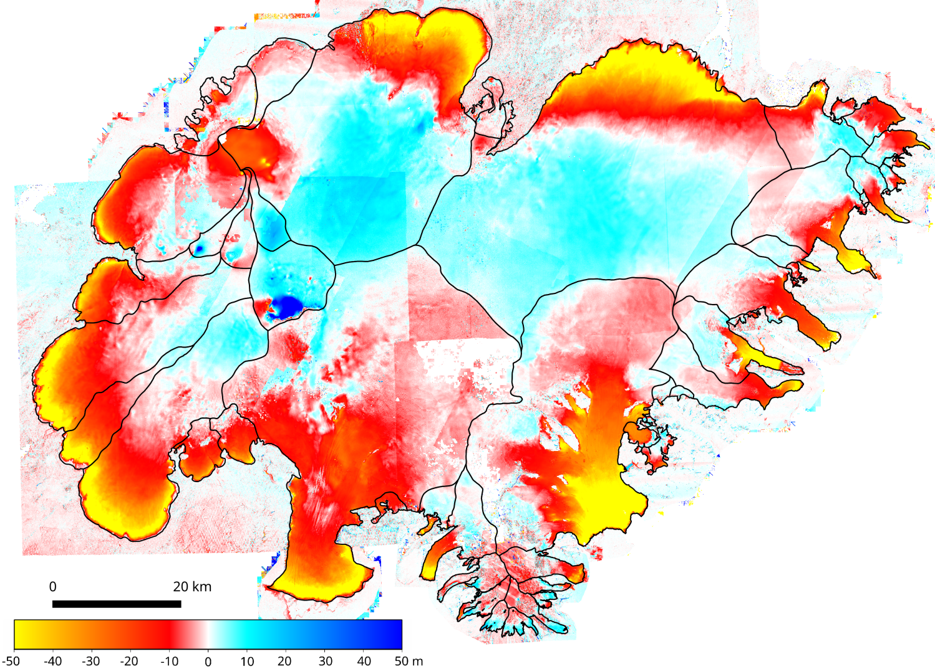
Vatnajökull: SPOT7 & Pléiades 2021
Vatnajökull: SPOT7 & Pléiades 2021
minus lidar (2010-2012)

Slide 8
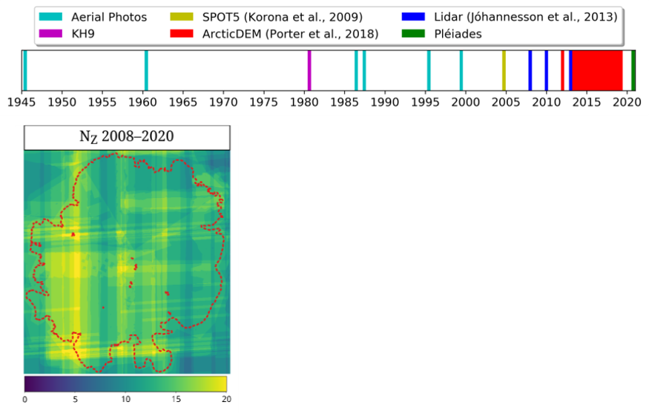
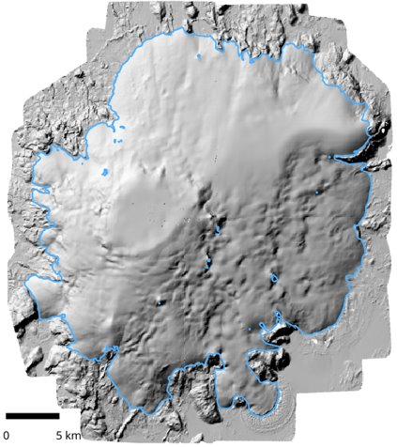
Gaussian Processes
Currently, each 5x5 grid cell in the glaciers have at least 10 accurate elevation measurements since ~2010 and ~20 elevation measurements since 1980.
Pléiades DEM, Oct 2020

Slide 9
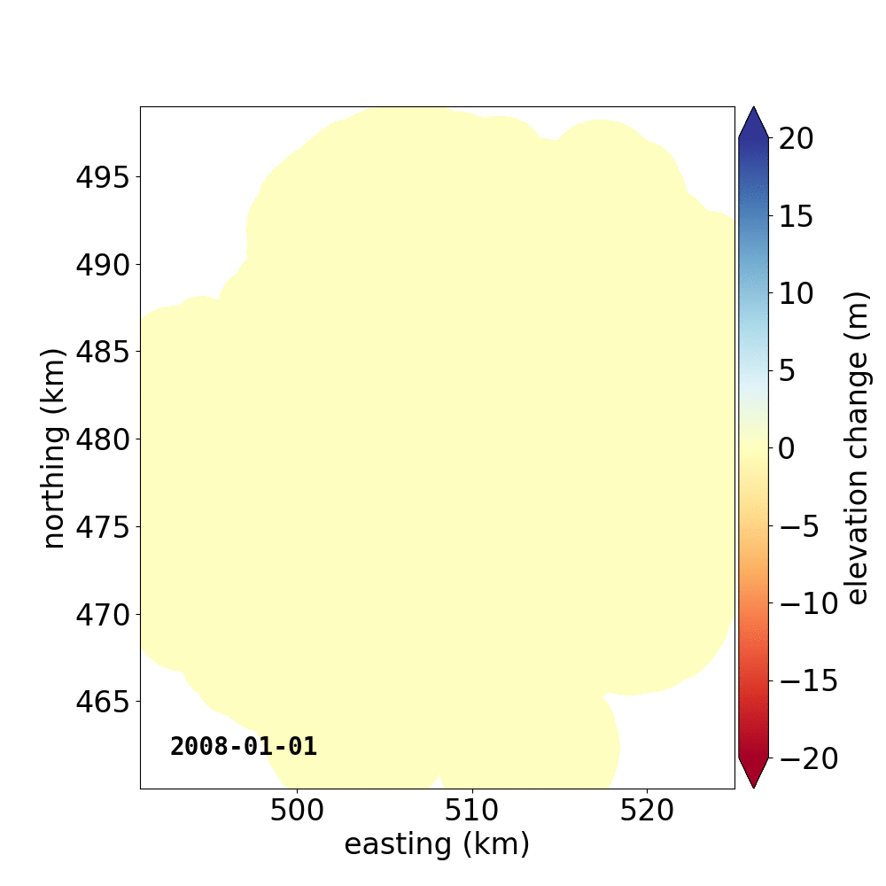
Gaussian Processes
Work based on Hugonnet et al. (Nature, 2021) stacking and gaussian processes.
End-goals:
1 - Automated pipeline to analyze and homogenize DEMs
2 - Explore the potential of Hugonnet’s method for annual and seasonal variations
3 - Further comparisons of glaciological vs geodetic glacier mass balance

Slide 10
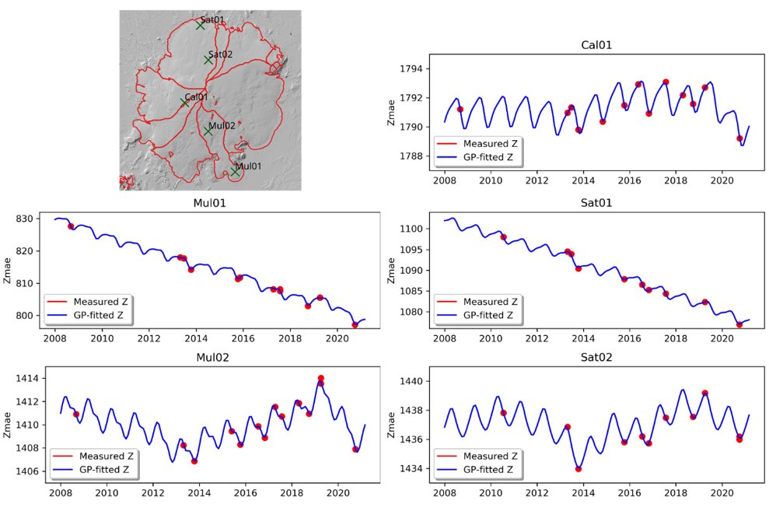
Gaussian Processes
Hofsjökull: Gaussian
Processes 2008–2020
Ablation area:
Acc. area:

Slide 11
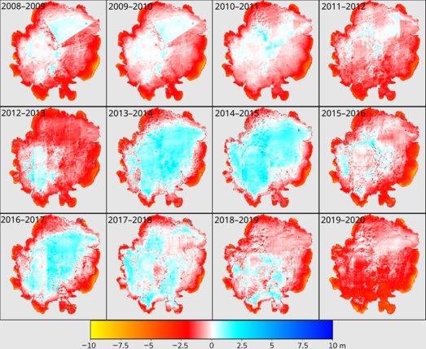
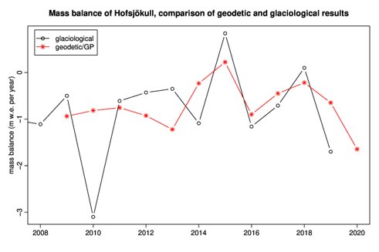
Gaussian Processes
Hofsjökull: Gaussian
Processes 2008–2020
Volume change to m w.e.:
ρ = 850 ± 60 kg m^{–3}
(Huss, TC, 2013)

Slide 12
Pléiades & SPOT7 surveys 2021

