Slide 1


QGIS Training NATT
Part 3: QField
May 2026
Krummasalir

Slide 2
QGIS Training NATT
Part 3: QField
At the end of the training, you should be able to:
Make a local QField project
Use QField on a mobile device
Connect to QField Cloud
Upload and Download data from QField Cloud
Edit Field data

Slide 3
Next Courses in Series
Part 1: QGIS basics -- this course
Part 2: Data sources in Iceland, WMS/WFS, Postgres connection, how to find data
Part 3: QField – this course
Part 4: Making sexy maps – Örnefni, styling, best practices with map making (August?)
Part 5: Digging deeper into vectors (September?)
Part 6: Working with raster data – DEMs and Satellite imagery (October?)

Slide 4
Recap
We learned to navigate QGIS (1)
We learned different coordinate systems (1)
We learned where to find different datasets and services (2)
We learned how to connect different services (2)
We learned to work with a Postgres database (2)
You can find this material here:
Or on Teams:
03_NATT_QIGS_NAMSKEID

Slide 5

Field Maps → QField

Slide 6
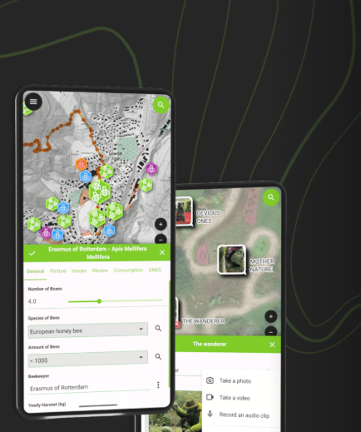
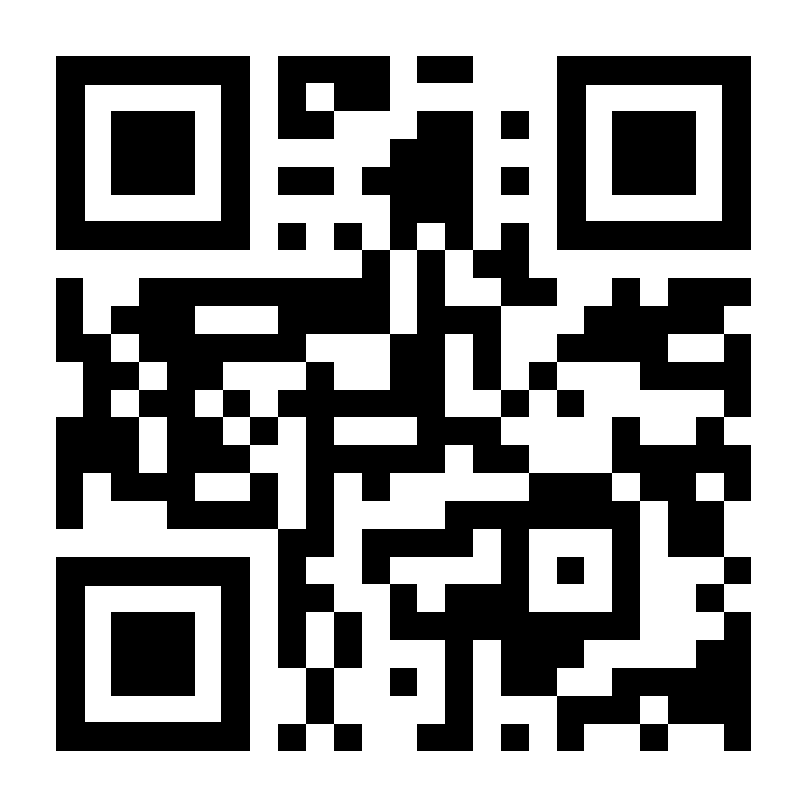

QField Mobile App

Slide 7
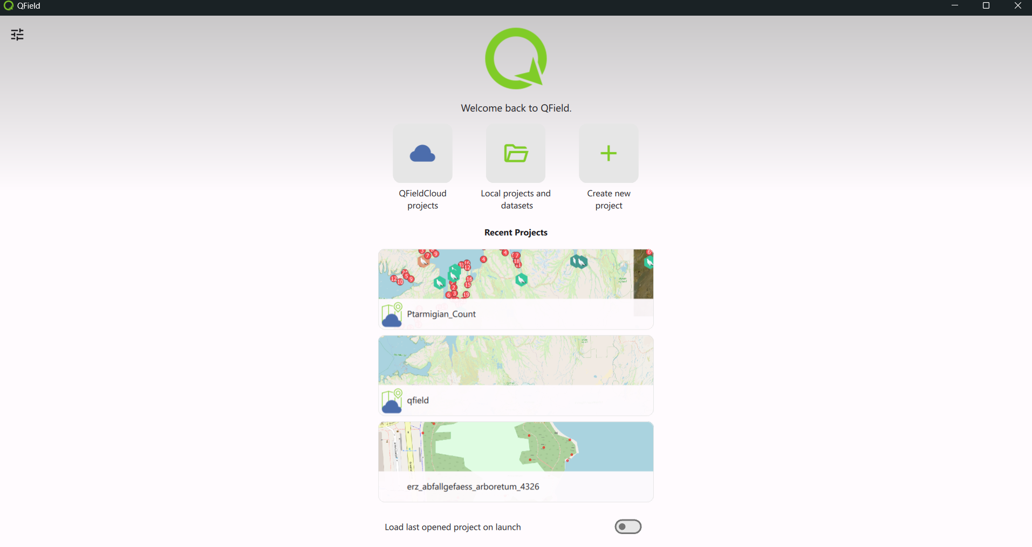
QField PC App

Slide 8
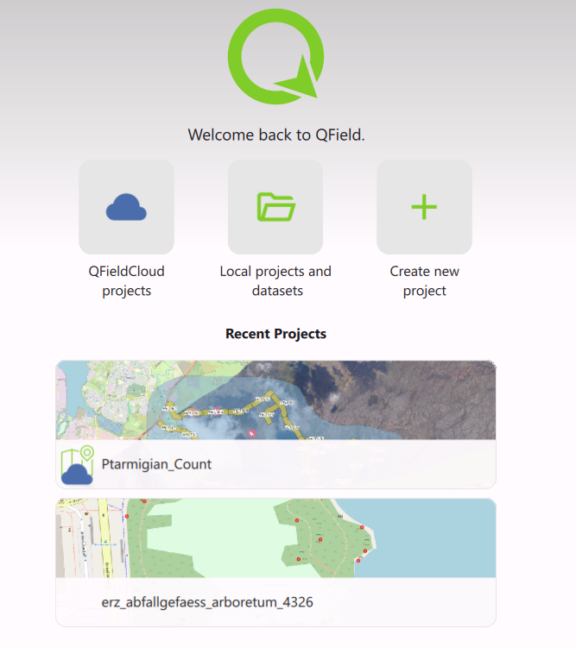
QField App
Exercise Part 1: Local
Exercise Part 2: Cloud

Slide 9
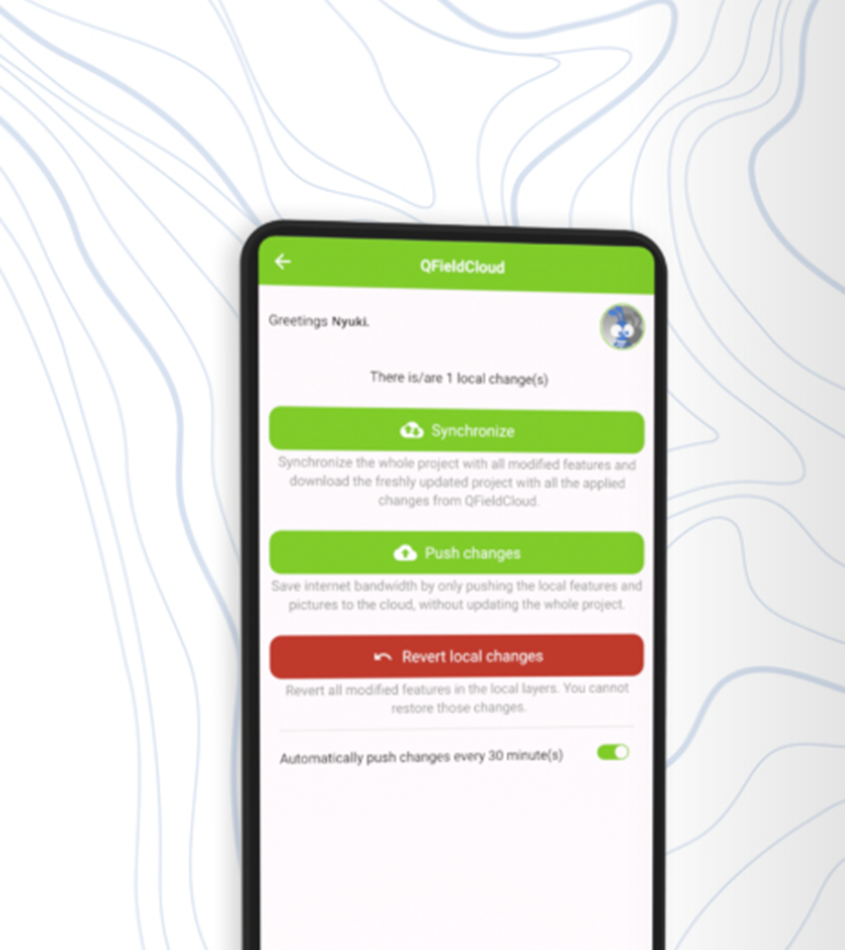
Sync and share your work

Slide 10
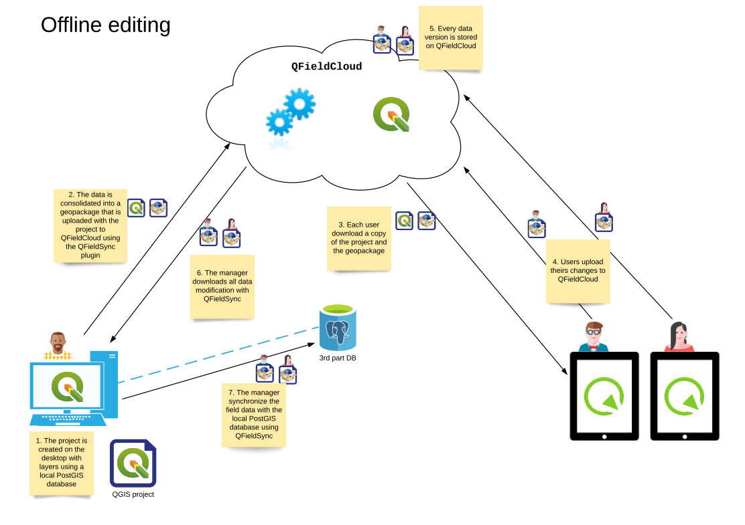
Sync your work

Slide 11

Deltas vs Sync
Deltas track of changes made in the project or on a feature. By pushing we send the changes, not the whole project.
Sync download and uploads all data, can be heavy and slow (especially in the field)

Slide 12
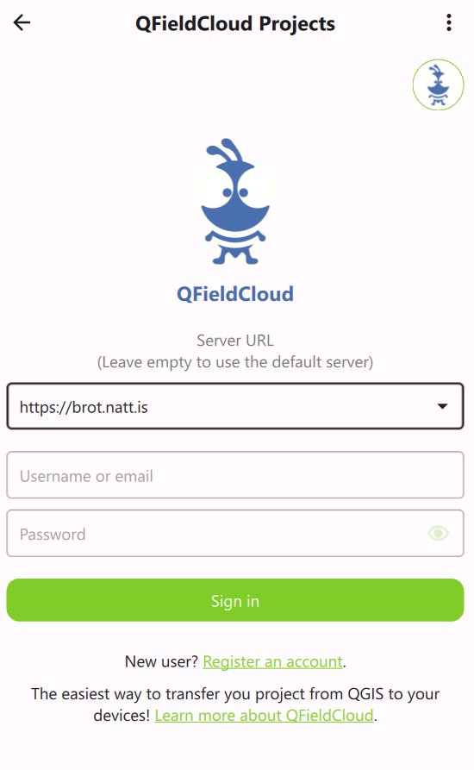
Access QField Cloud
Double click
Important!
Double click on the QField Cloud Ant to get the Server URL menu.
Add https://brot.natt.is as a server URL.
If you do not do this you will try to connect to the official QField Cloud website and not the one from NÁTT

Slide 13
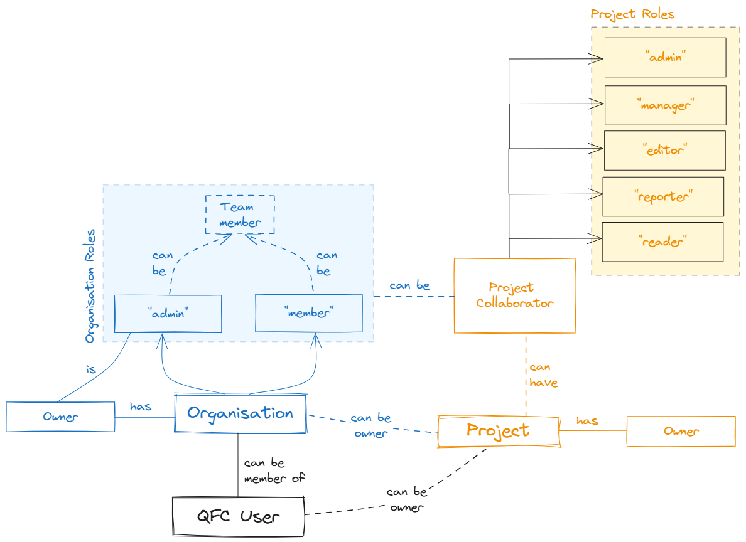
Roles and Entities

Slide 14
Cloud Roles
Admin →Full project administration: can rename or delete the project, and generally has the same rights as the project owner except transferring ownership.
Manager → Can add or remove project collaborators. In practice, this is for managing access/configuration rather than doing more field editing than an editor.
Editor → Can edit data: create, modify, and delete features/data.
Reporter → Can insert new data only; cannot update or delete existing data.
Reader → Read-only access; can view/read data but not edit it.

Slide 15
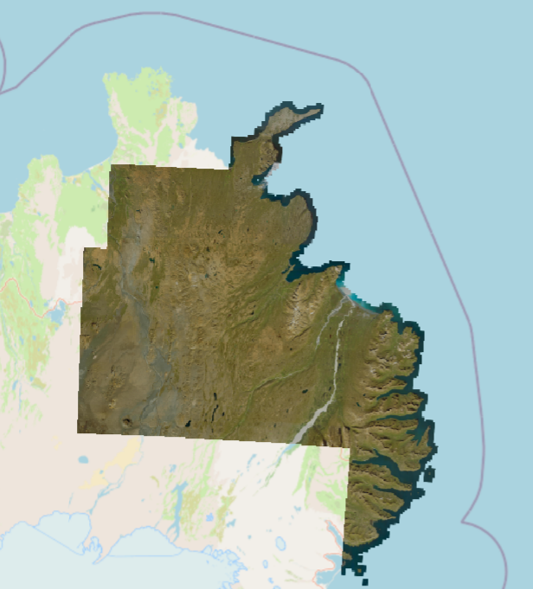
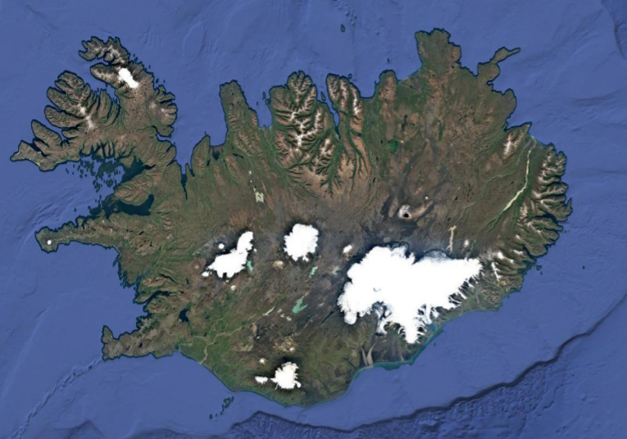
Online Basemaps and Basedata
In QField we can add our online basemaps
WMS, WMTS, XYZ as we learned in our previous lesson.
Example:
https://gis.natt.is/mapcache/web-mercator/wmts?SERVICE=WMTS&REQUEST=GetCapabilities
http://mt0.google.com/vt/lyrs=s&hl=en&x={x}&y={y}&z={z}

Slide 16

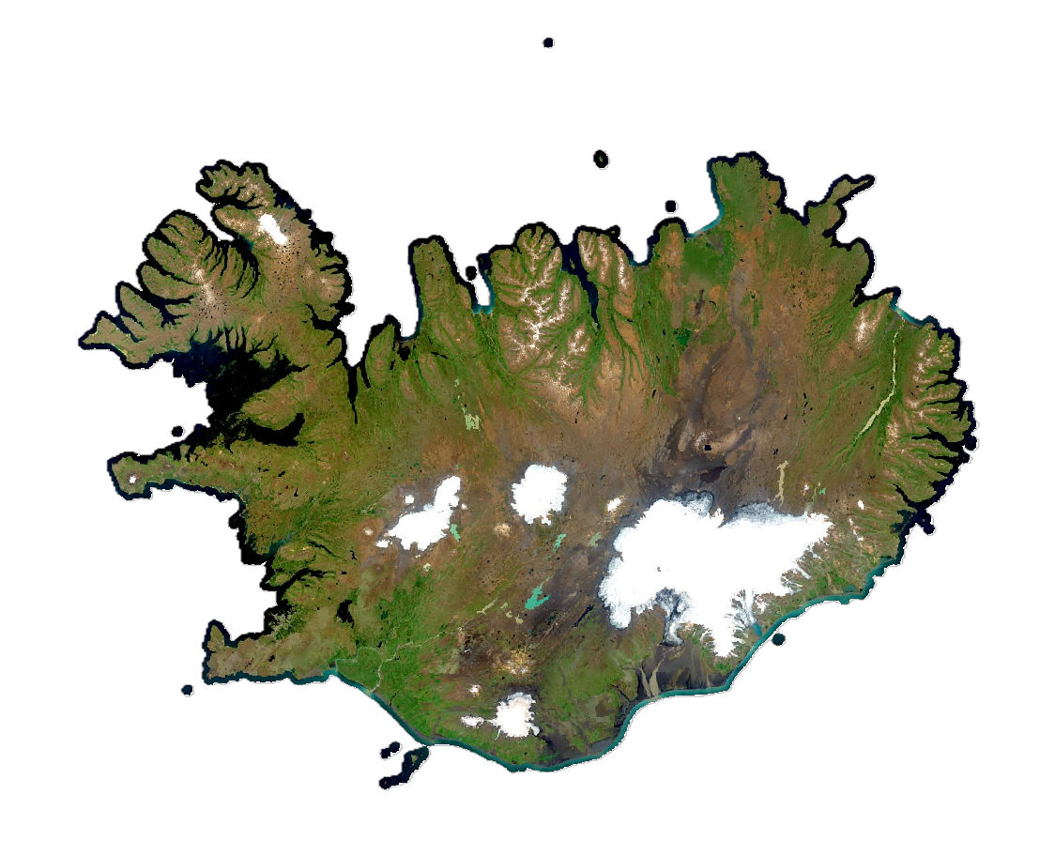
Offline Basemaps and Basedata
We can have offline maps when we do not have connection
Difference between raster and vector
Sentinel 2 Mosaic 190 MB (10m res)
Local or QField Cloud shared_datasets
between projects to save space
https://ftp.natt.is/public/marco/imagery/
Work in progress…

Slide 17
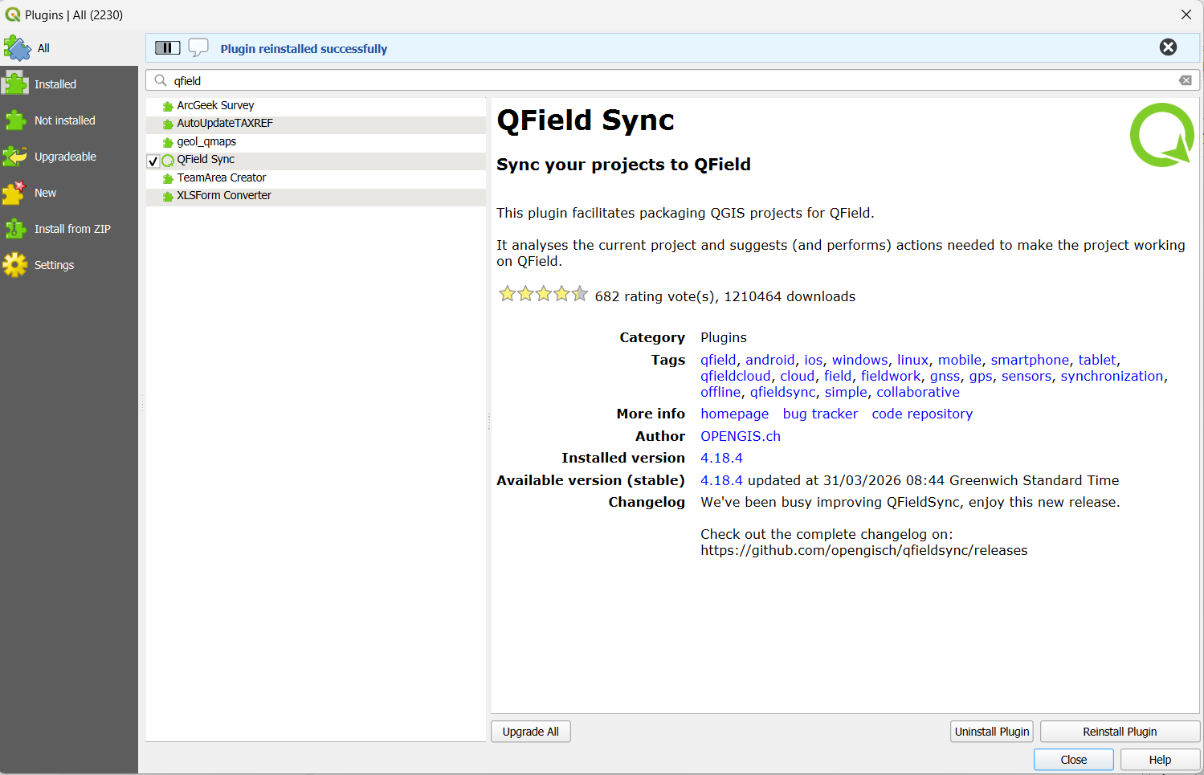
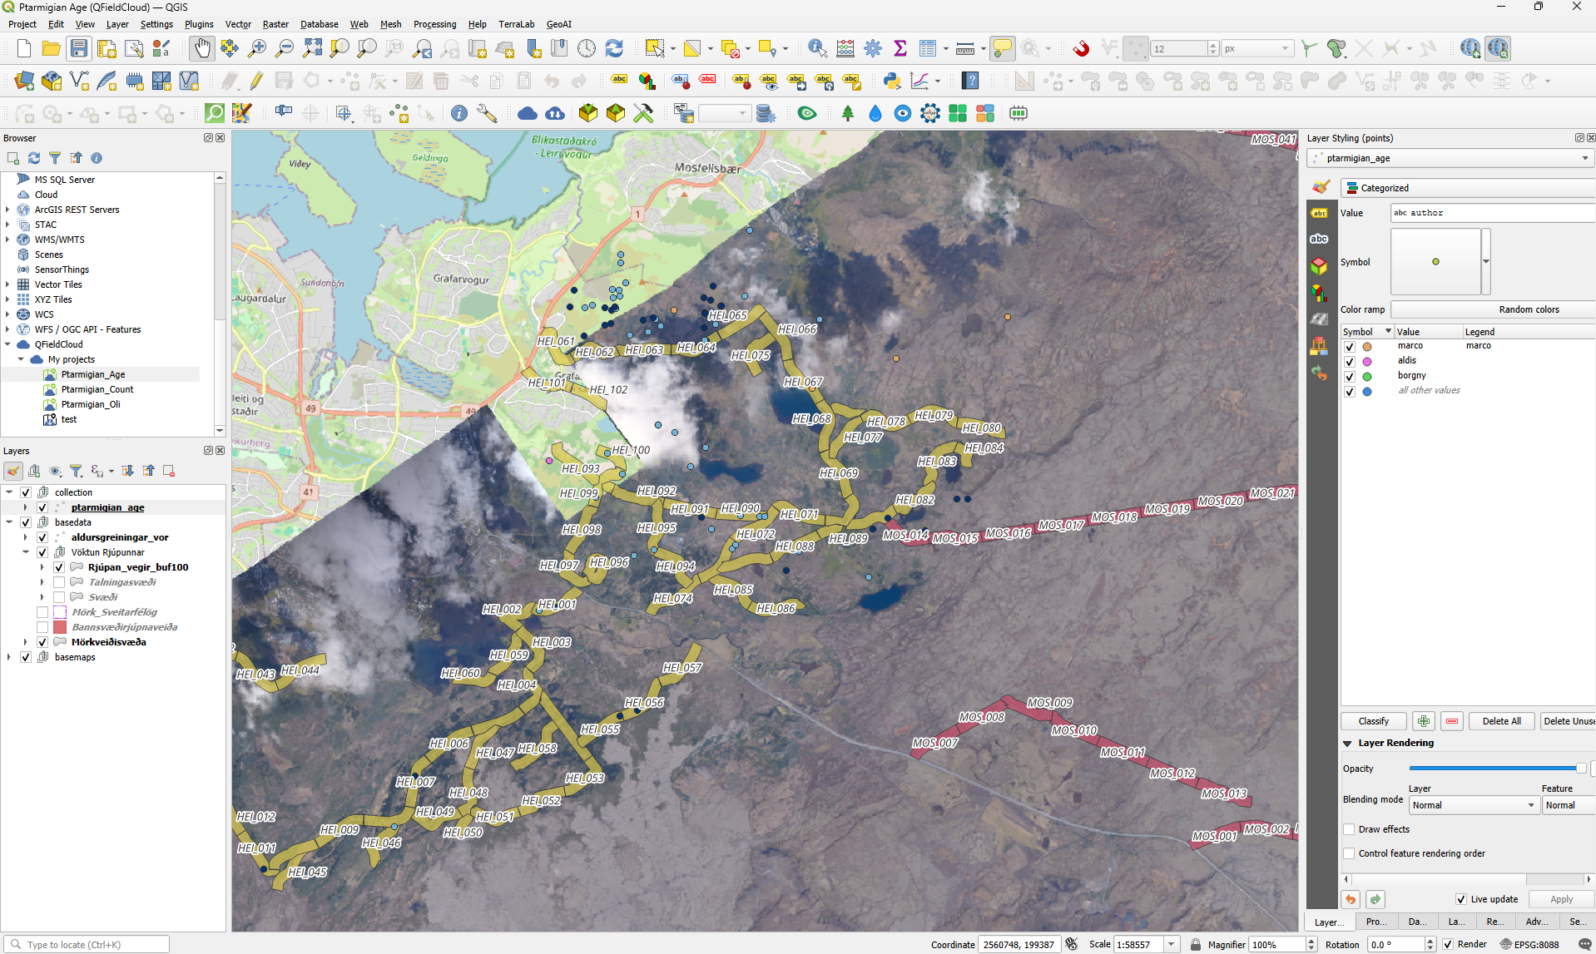
QField in QGIS

Slide 18
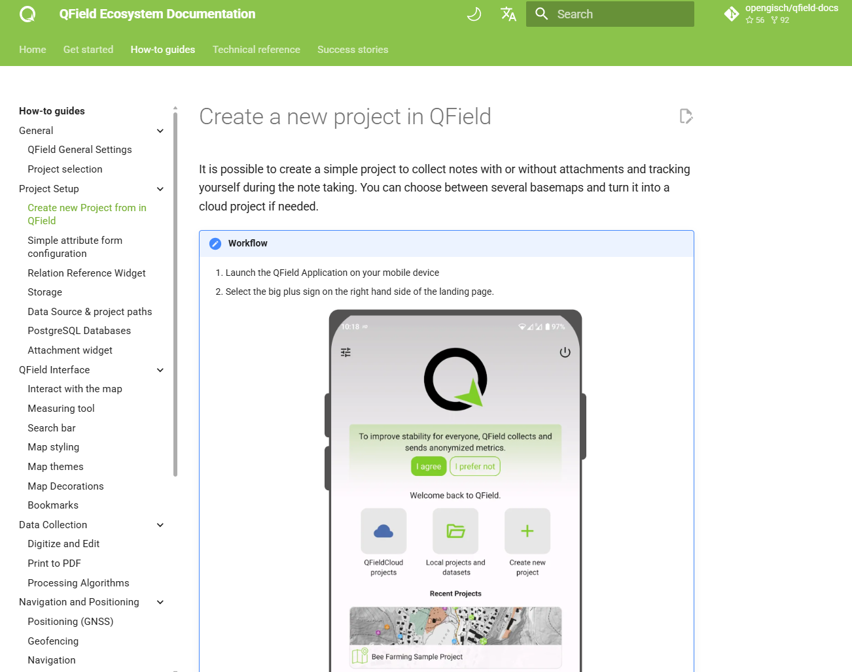
QField in QGIS
https://docs.qfield.org/how-to

Slide 19

How to start to make your own simple project

Slide 20

Install QField

Slide 21



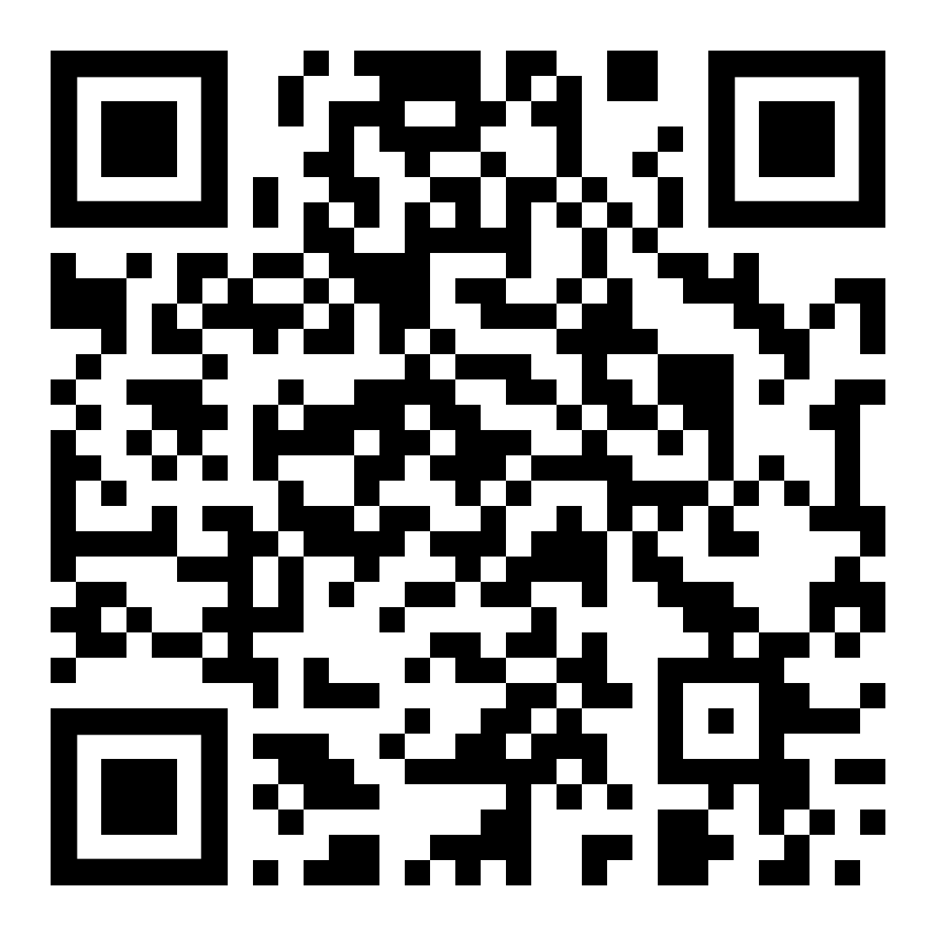
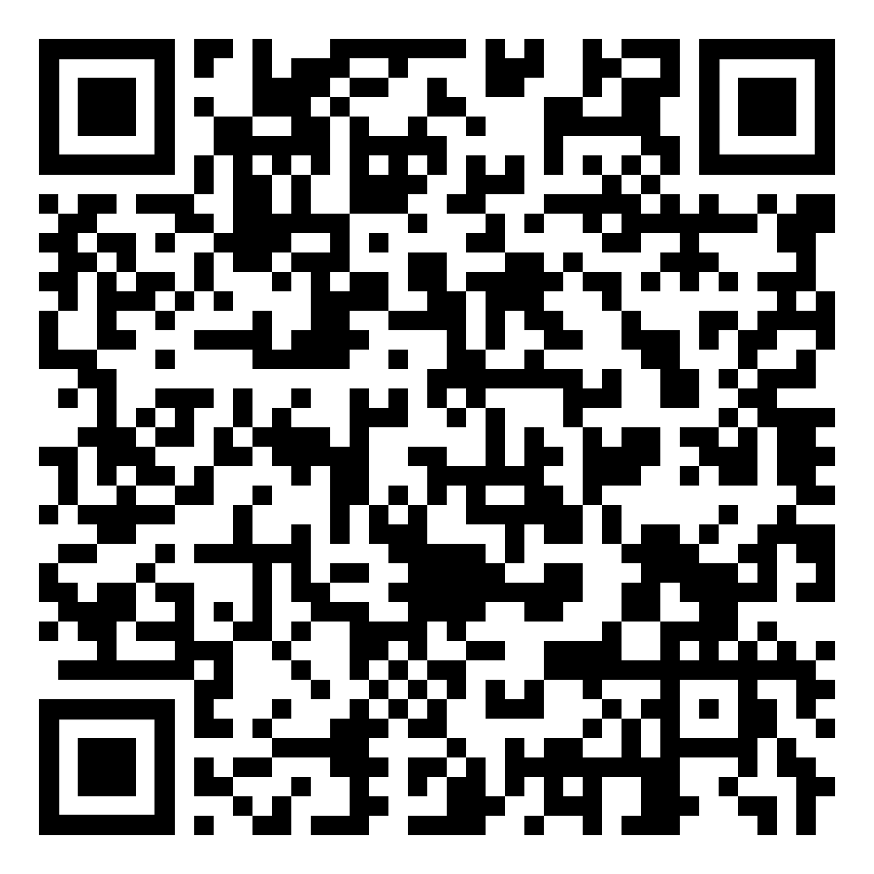
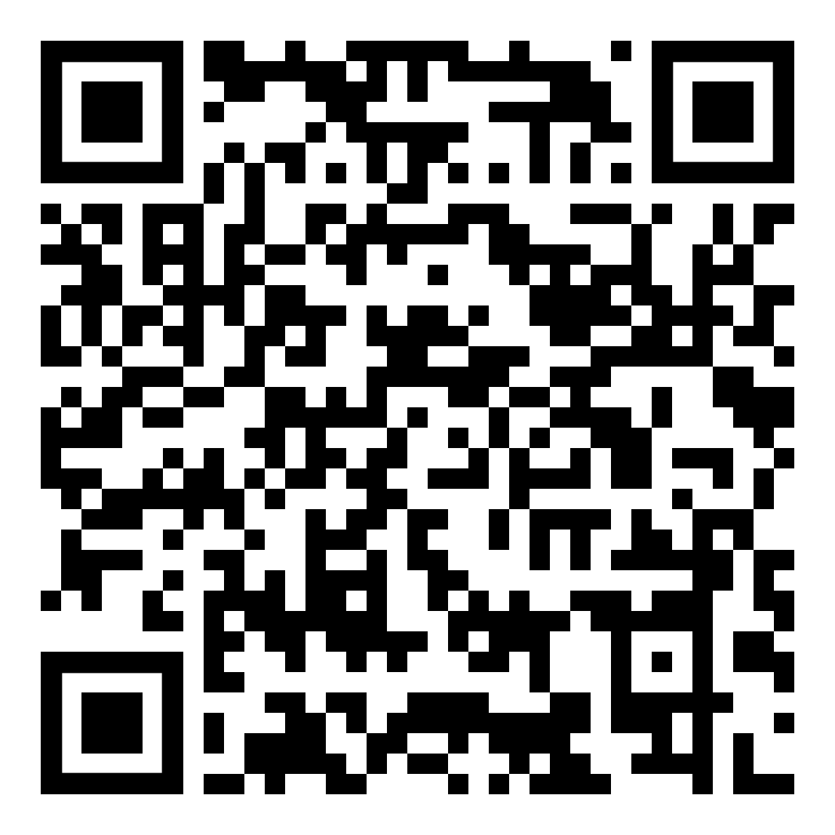


Slide 22
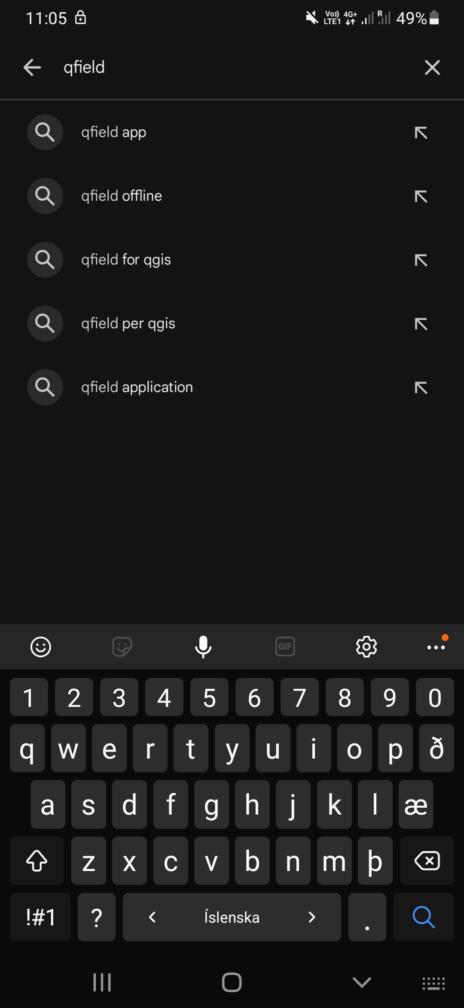
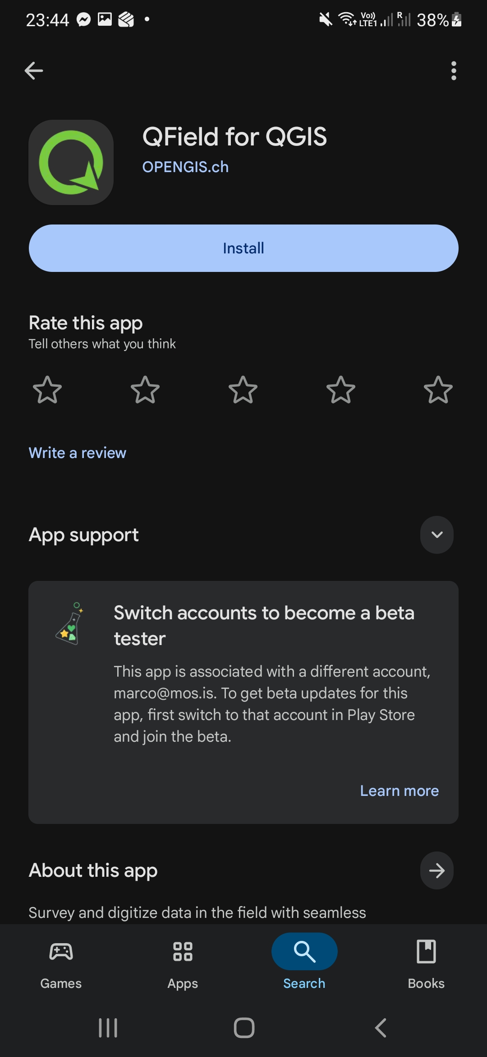
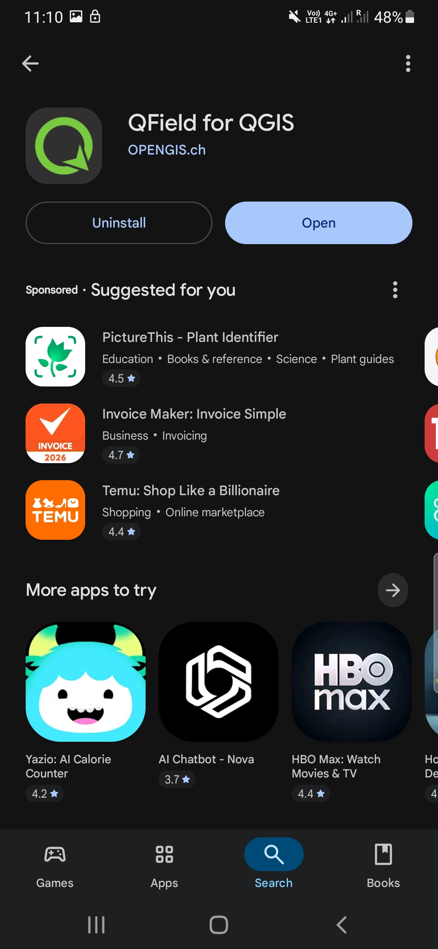

Slide 23

Your Local Project

Slide 24
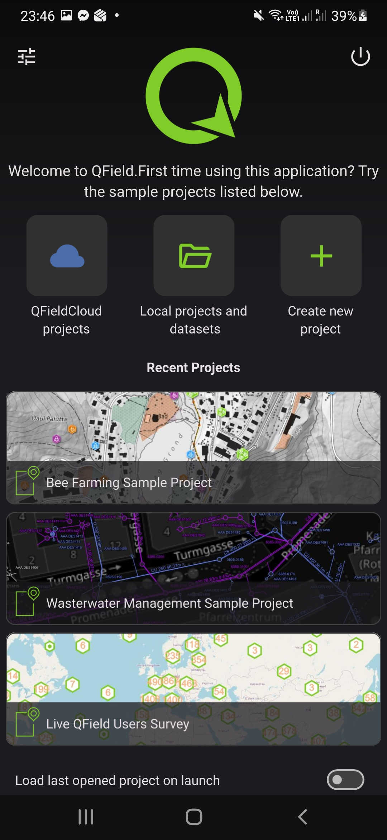
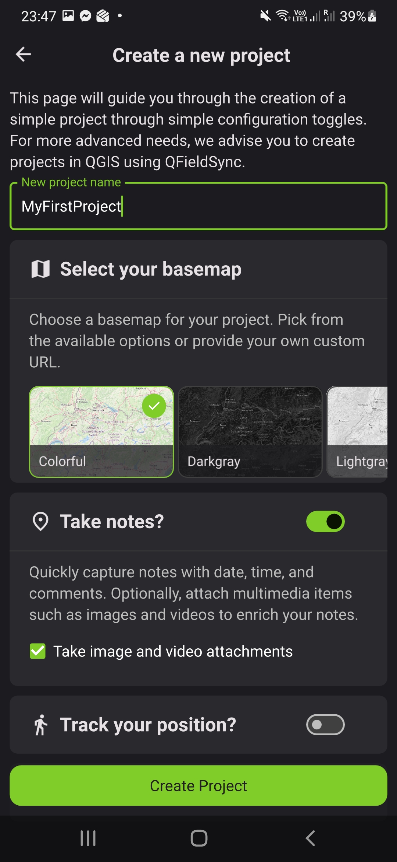
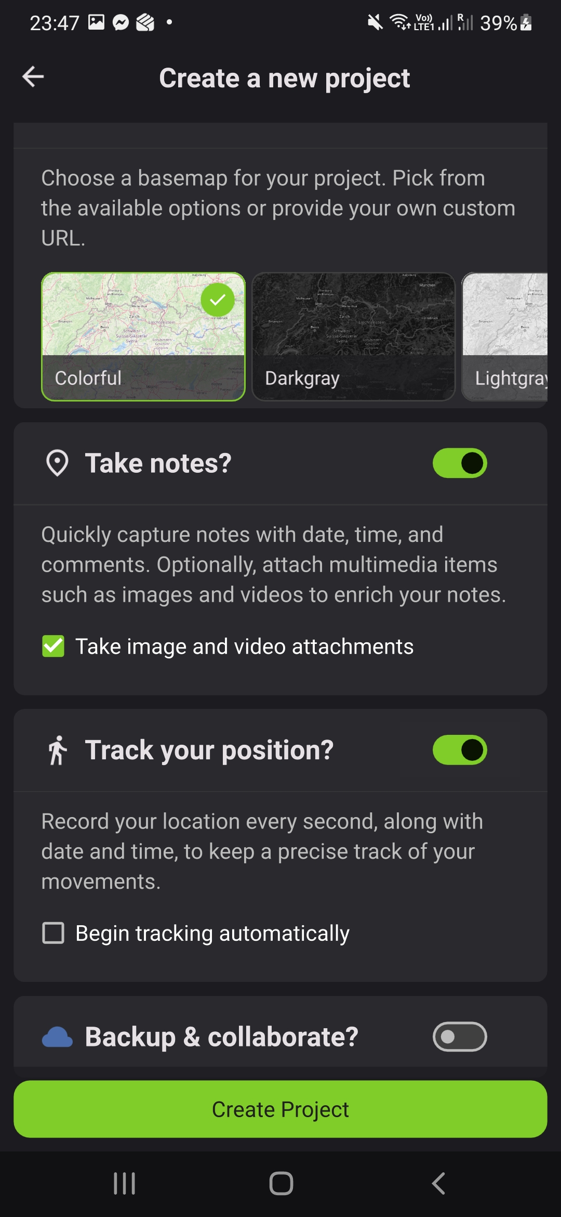
1
2
3
4

Slide 25
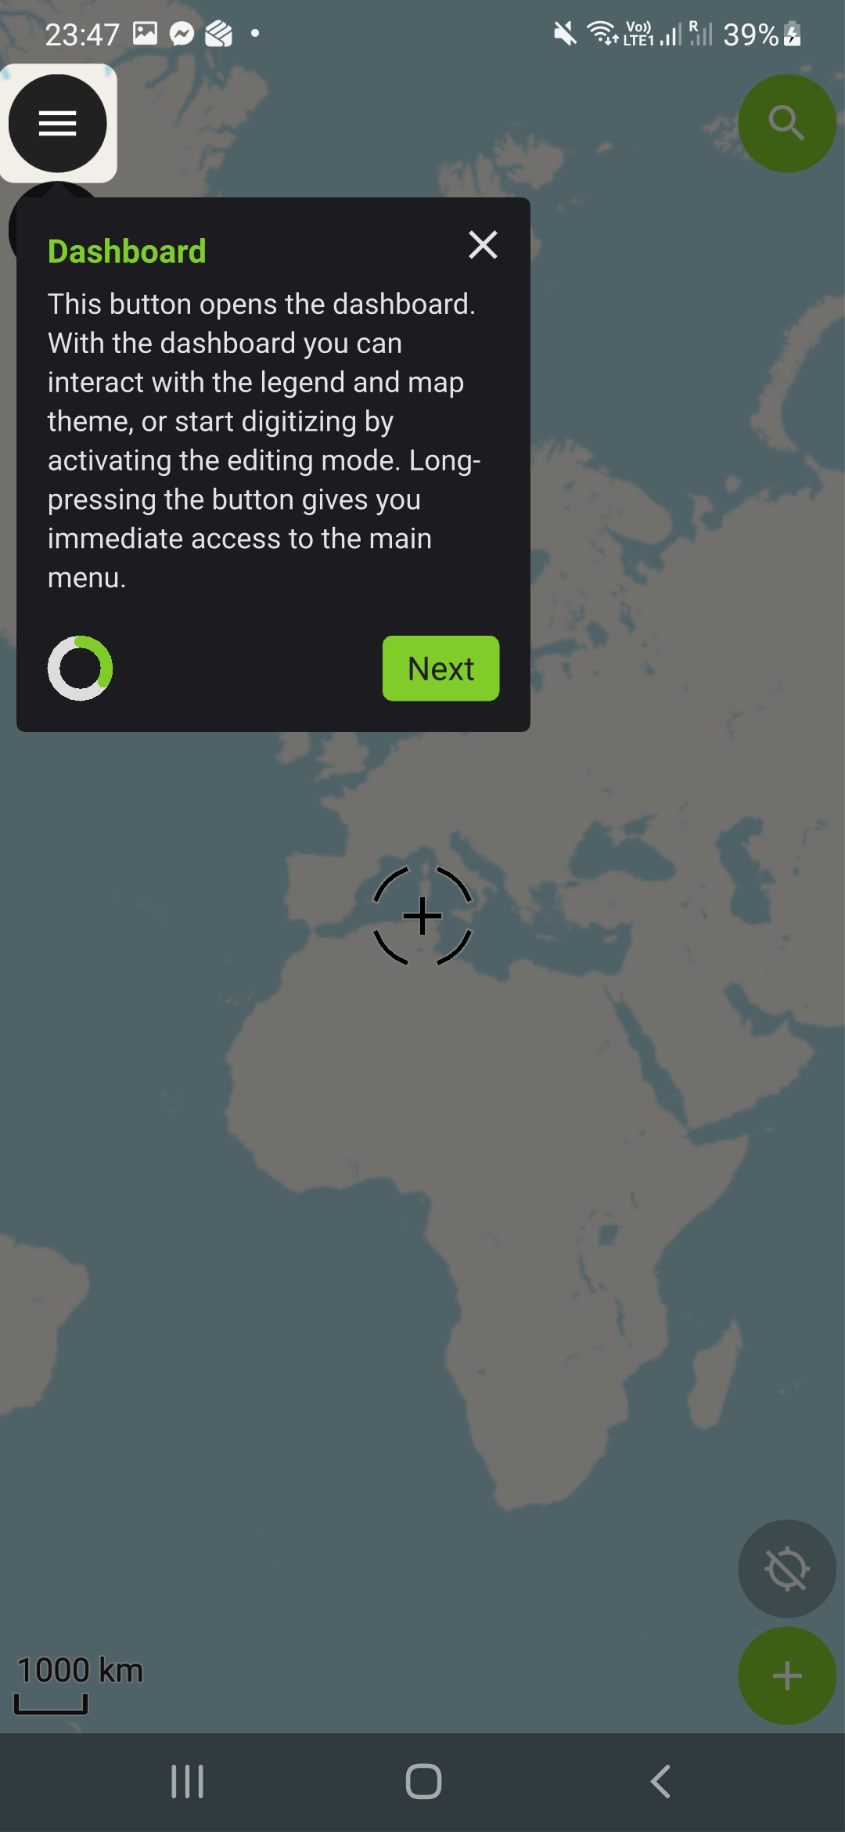
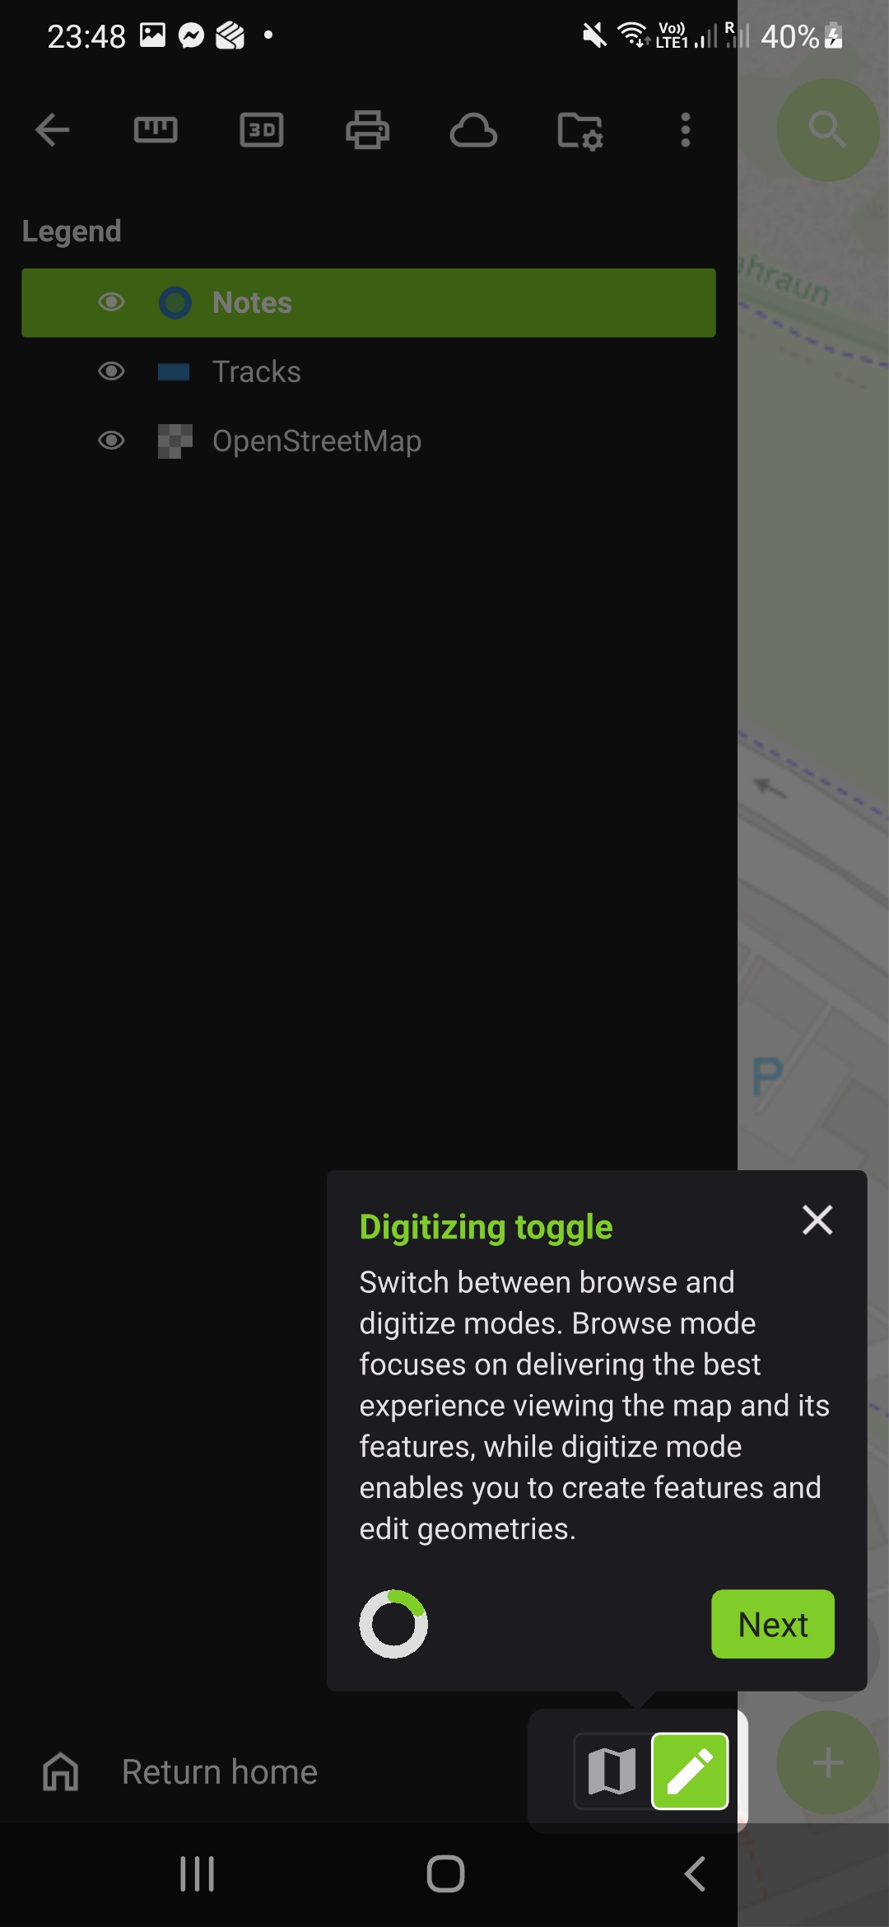
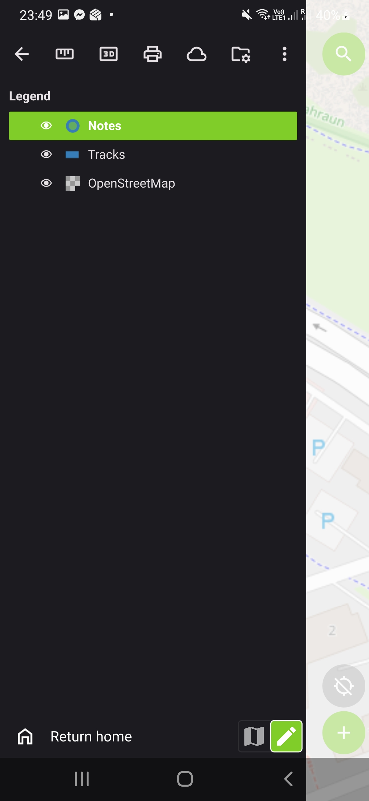
Edit

Slide 26
Measure

Slide 27
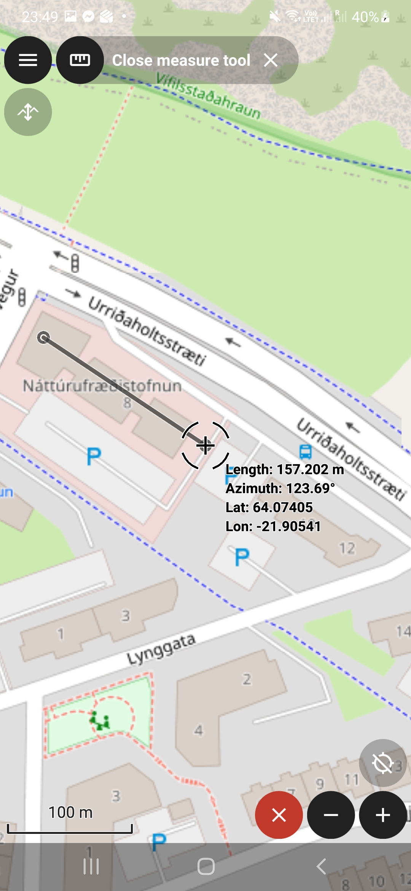
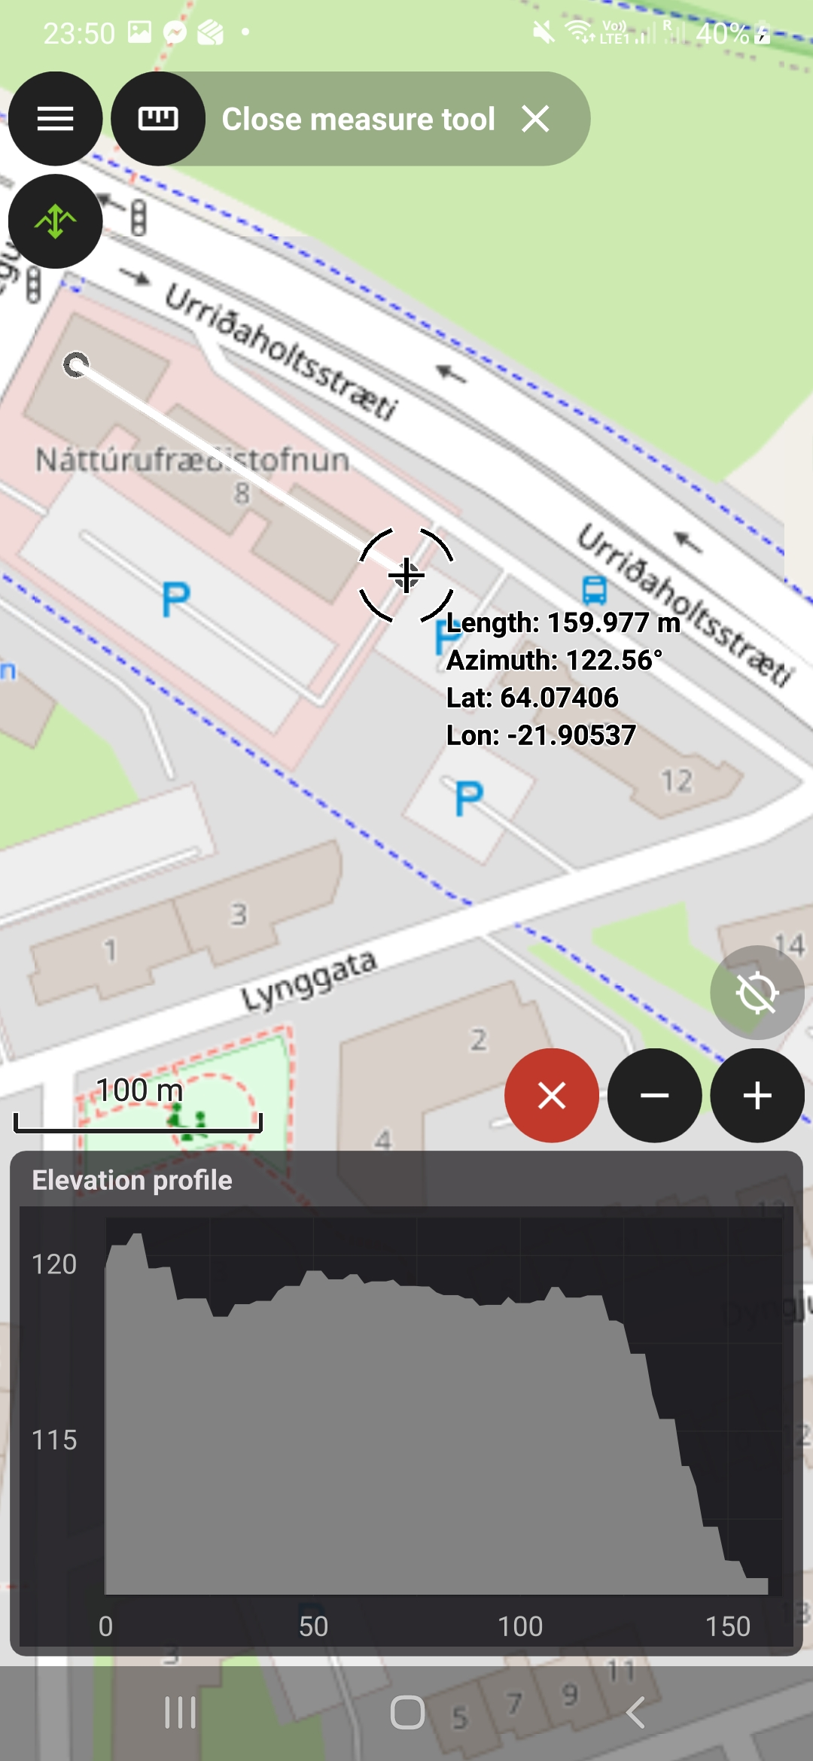
3
1
1
2
2

Slide 28
3D view and orient

Slide 29
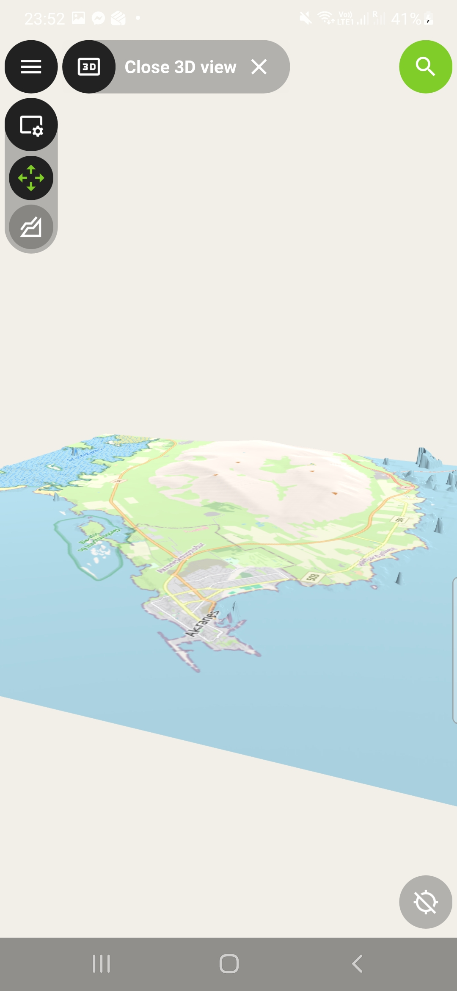
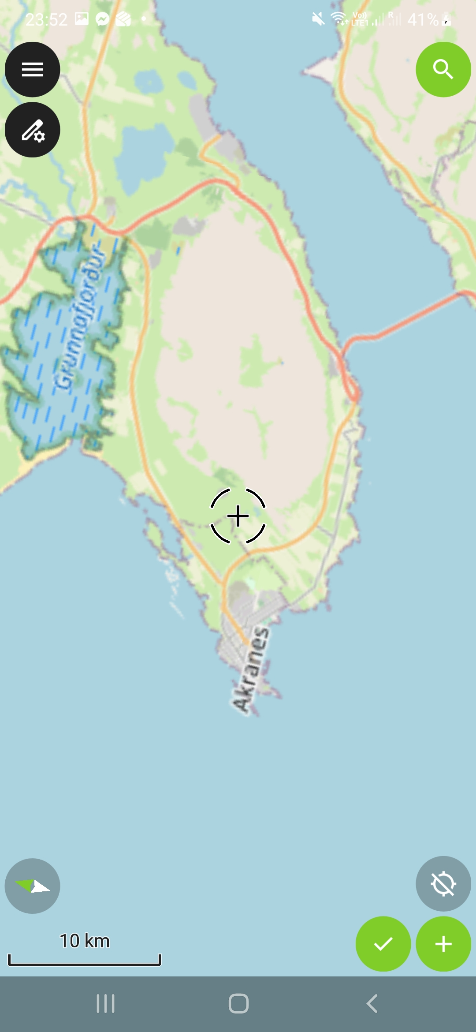
3
2
2
1
1

Slide 30
Search

Slide 31
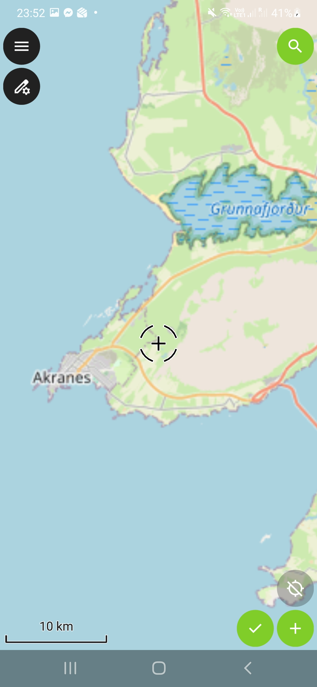
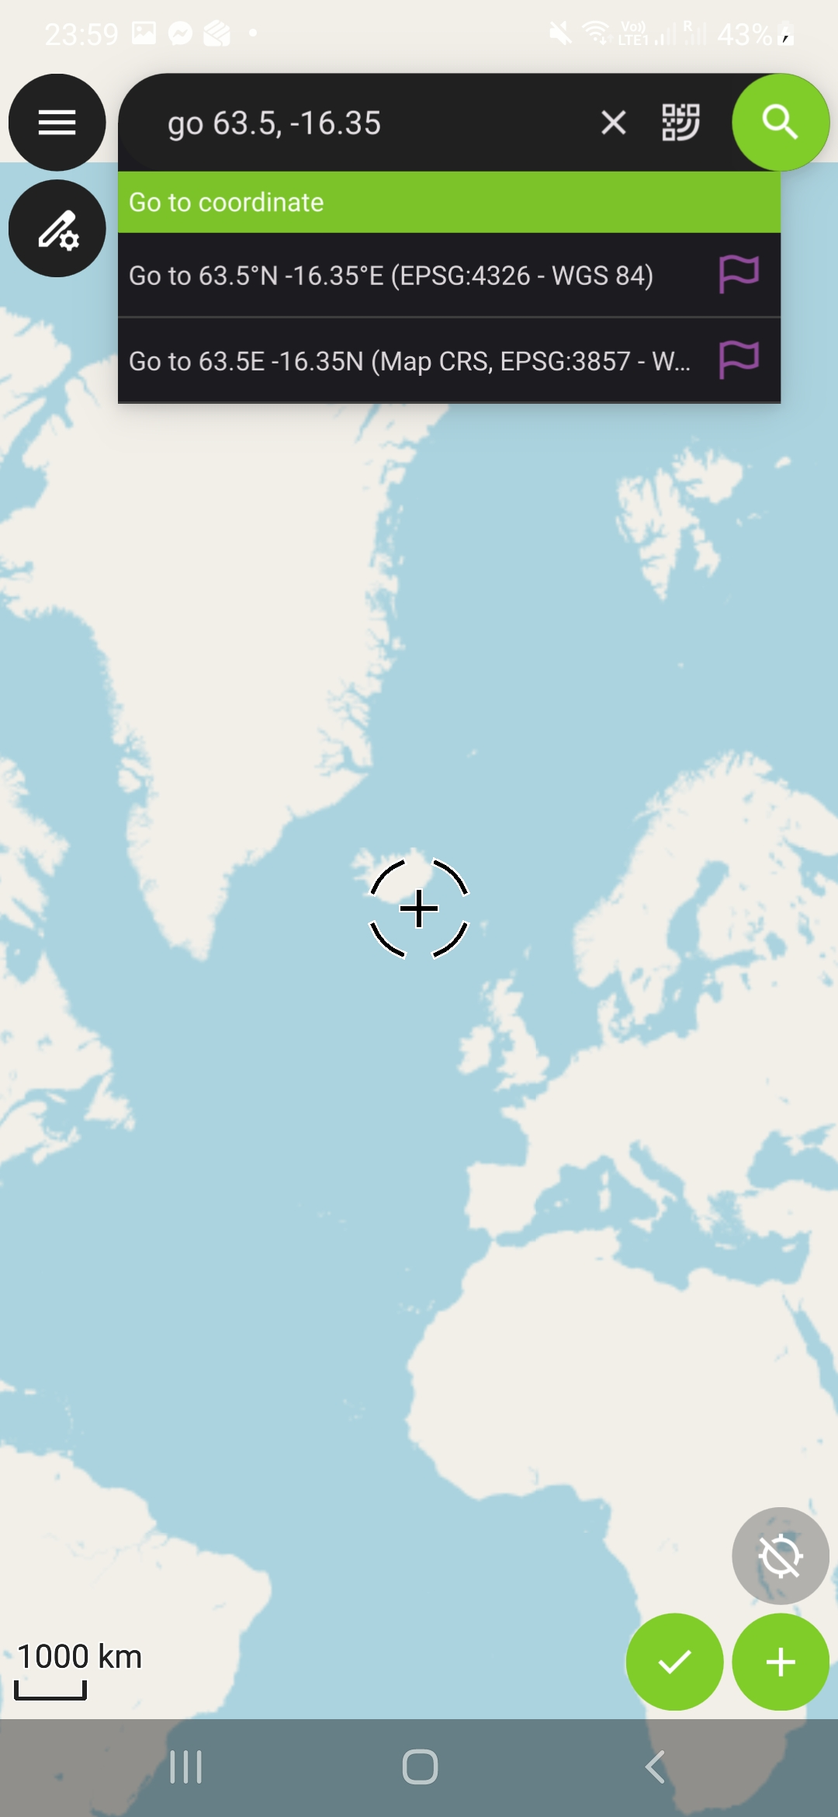
3
1
2
1

Slide 32
Add a point

Slide 33
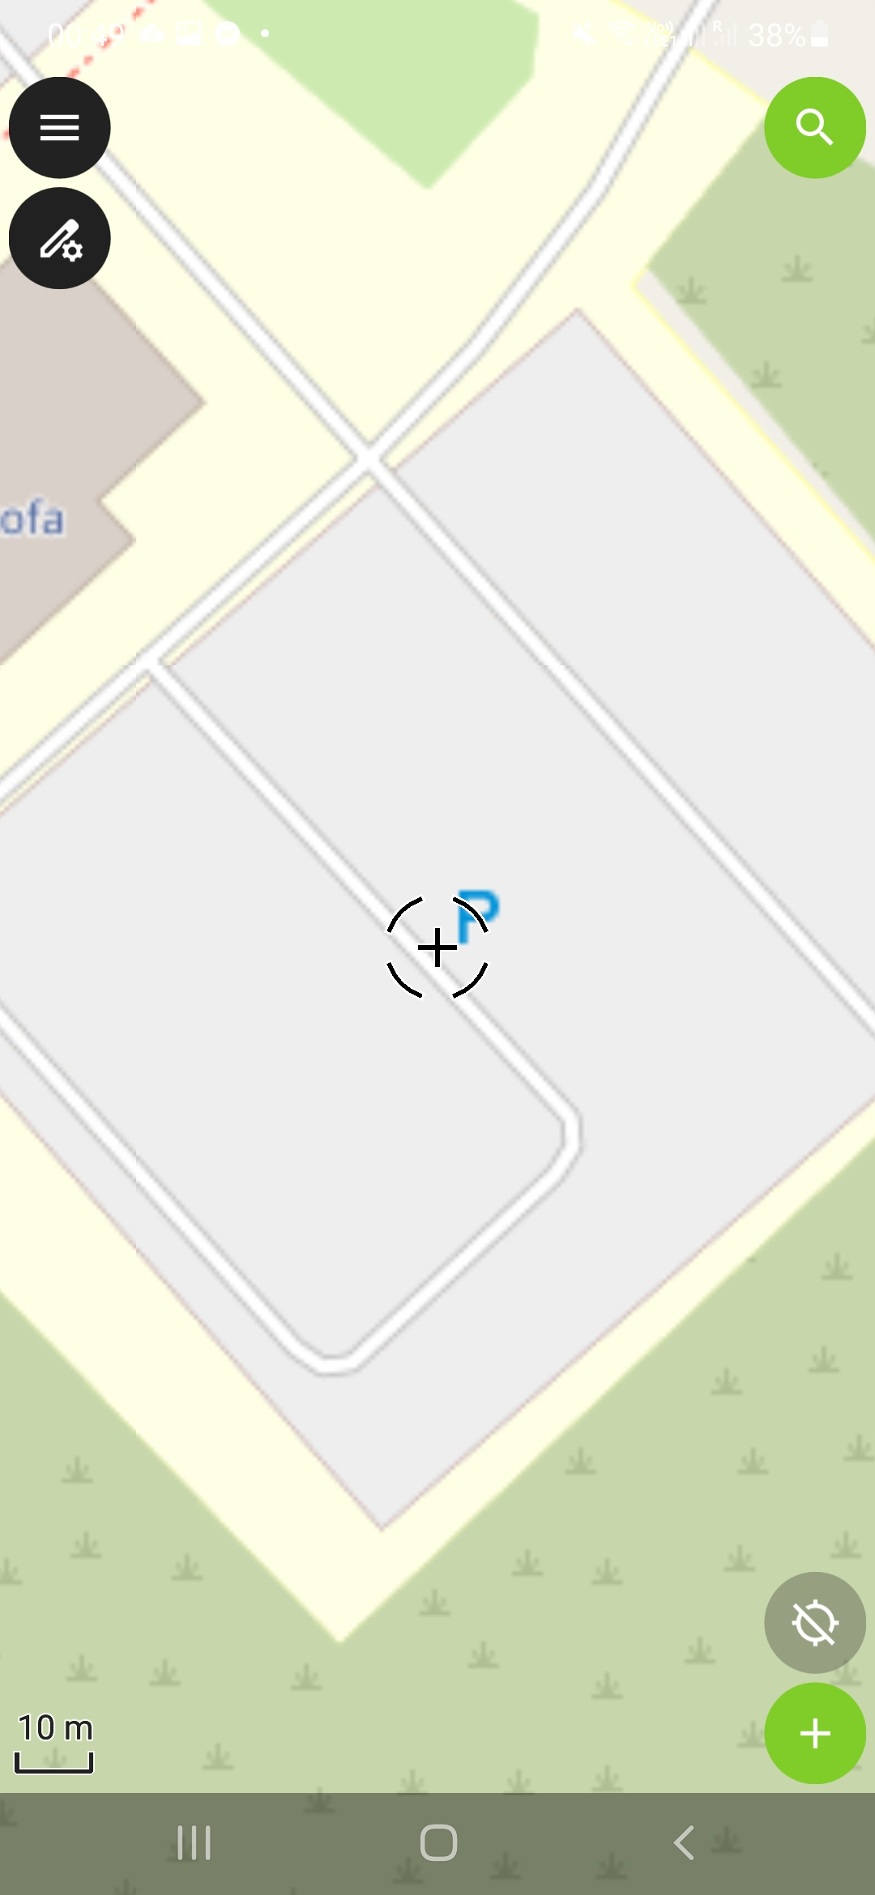
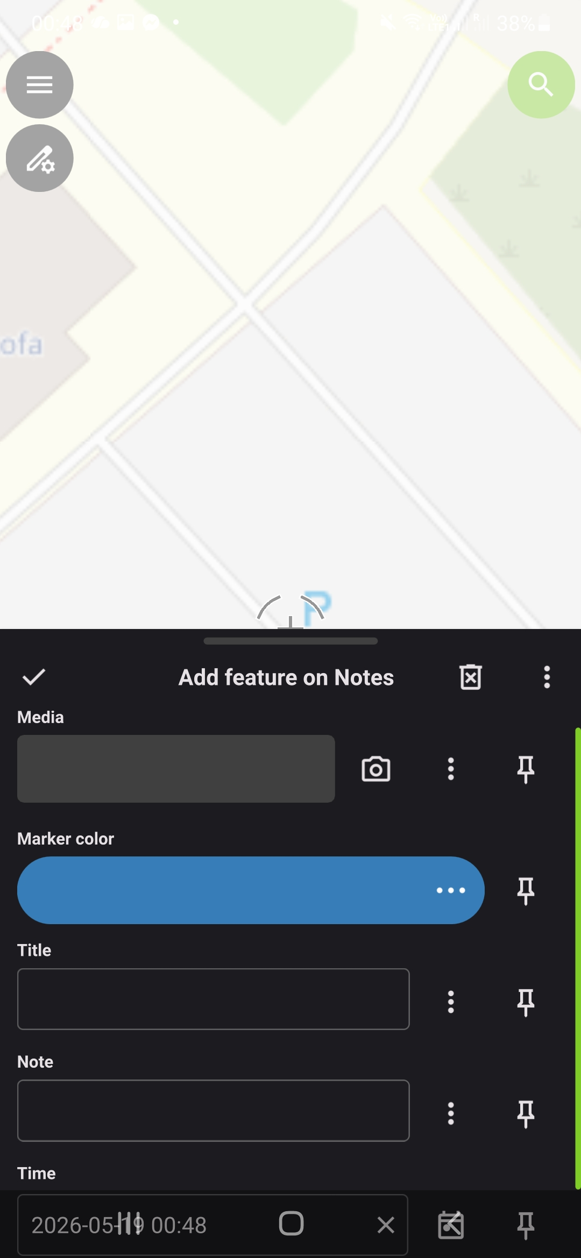
2
Click here to use GPS
1

Slide 34
Take a picture

Slide 35
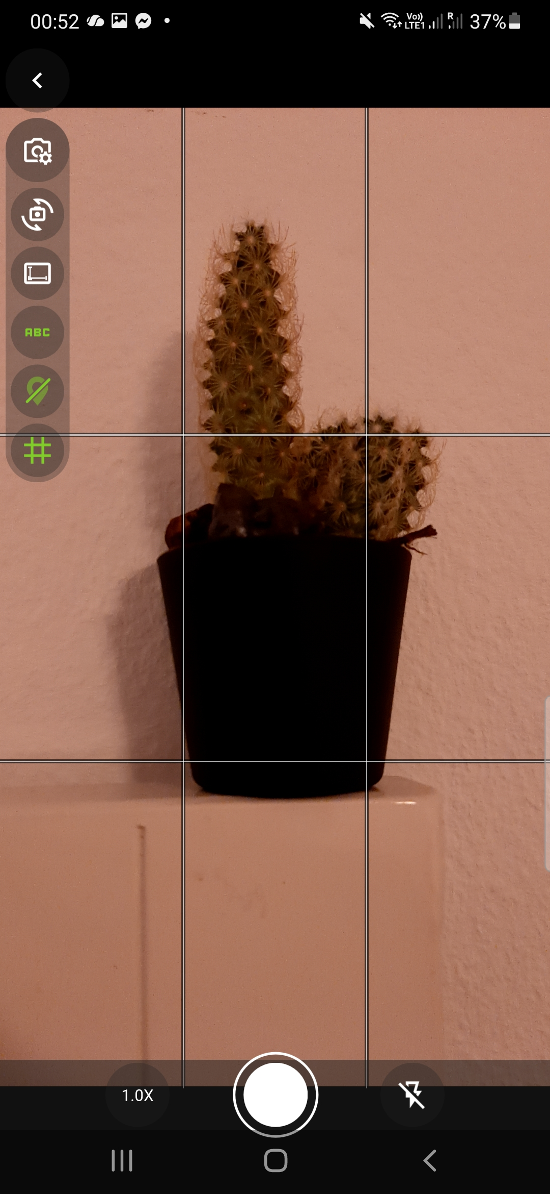
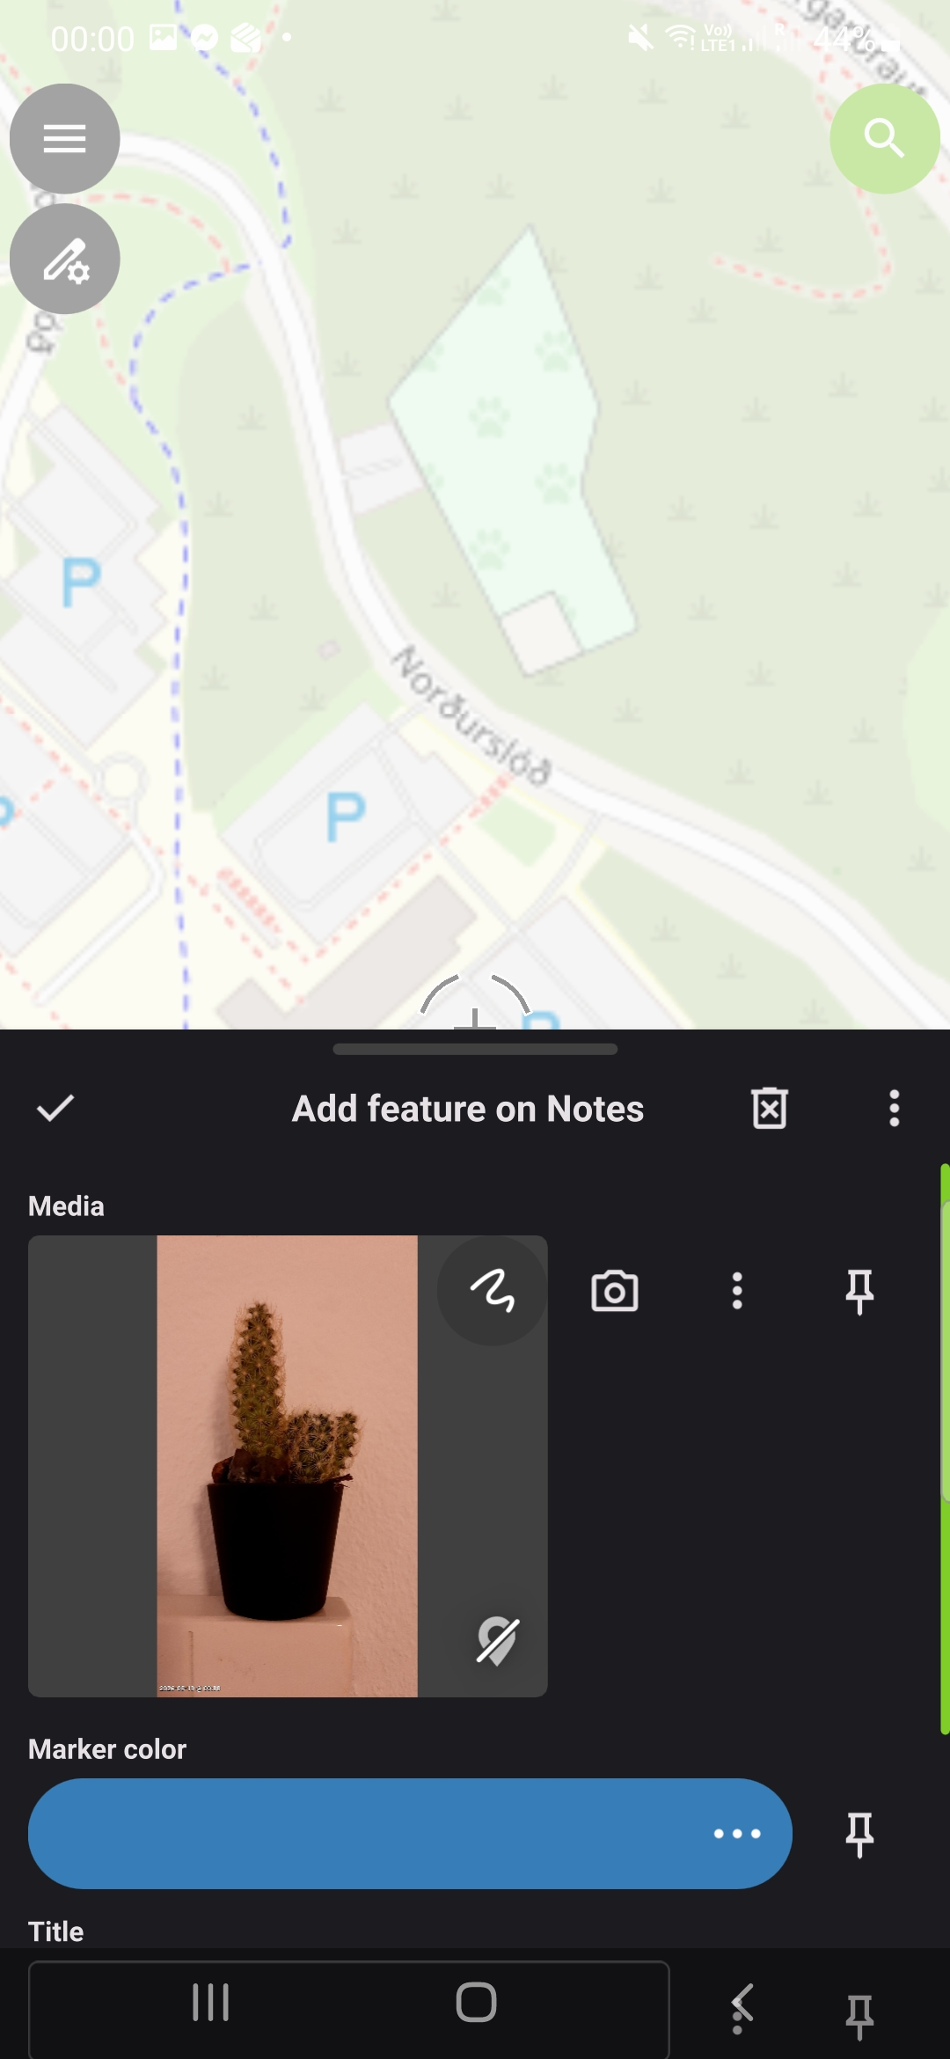
Add geotag (needs GPS on)

Slide 36
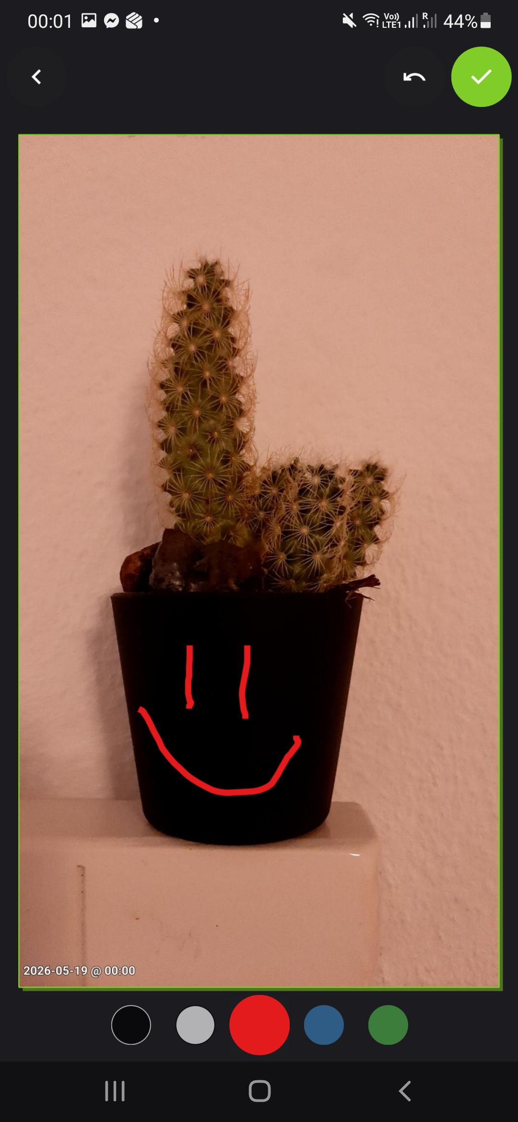
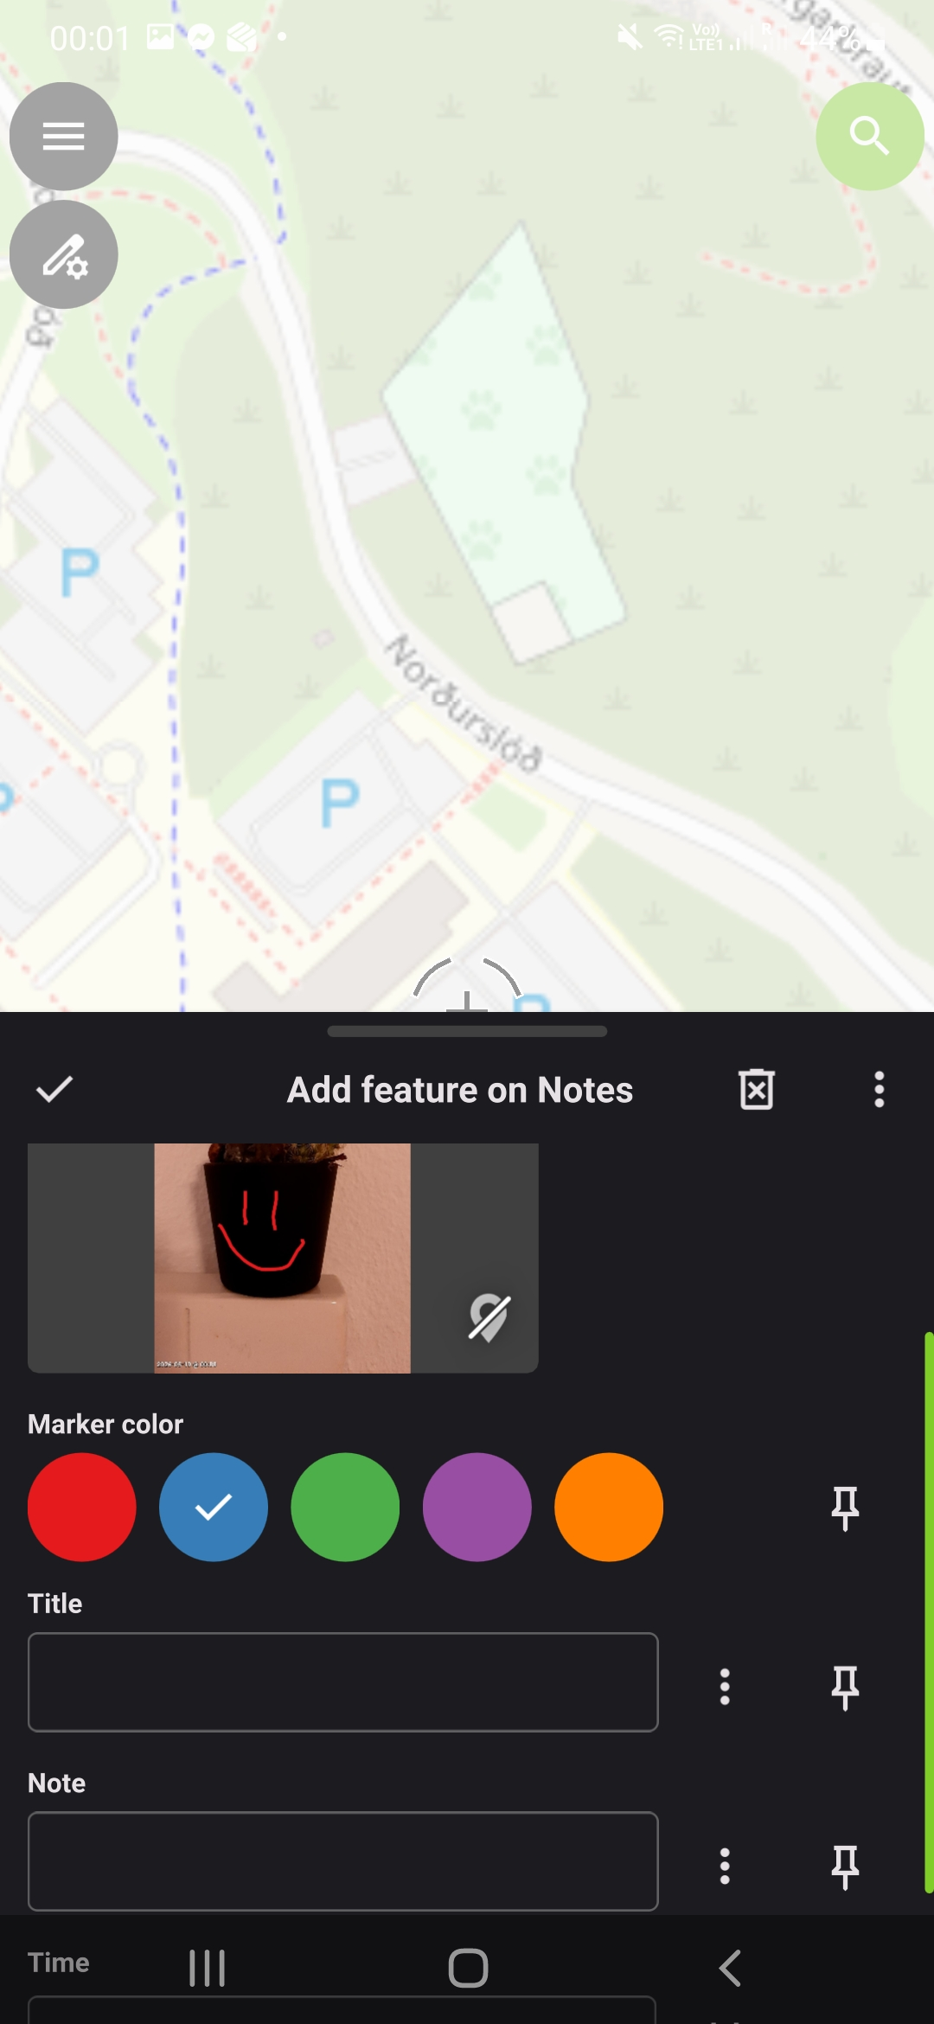
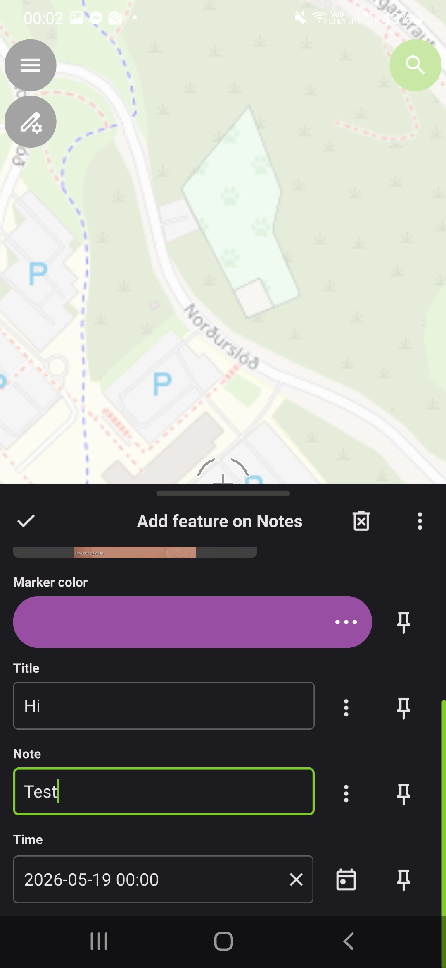
2
if you prefer to discard
4
1
1
2
1
3

Slide 37
Edit Point

Slide 38
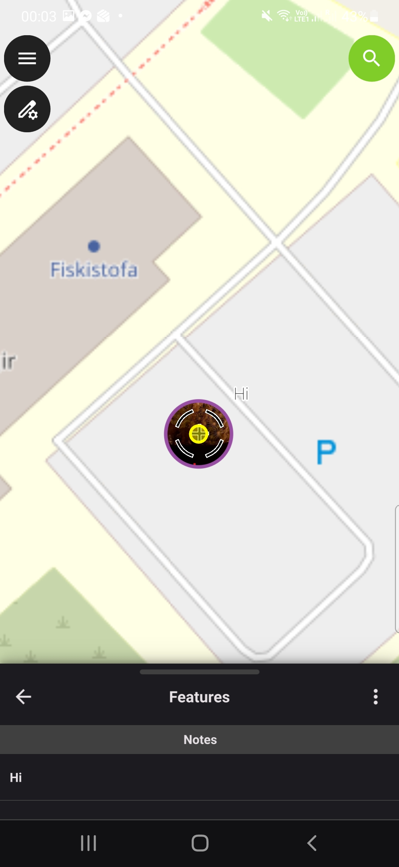
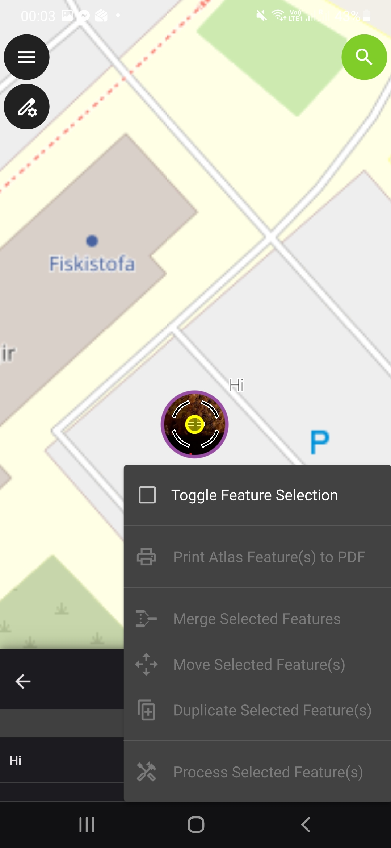
1
1
2
2

Slide 39
Move

Slide 40
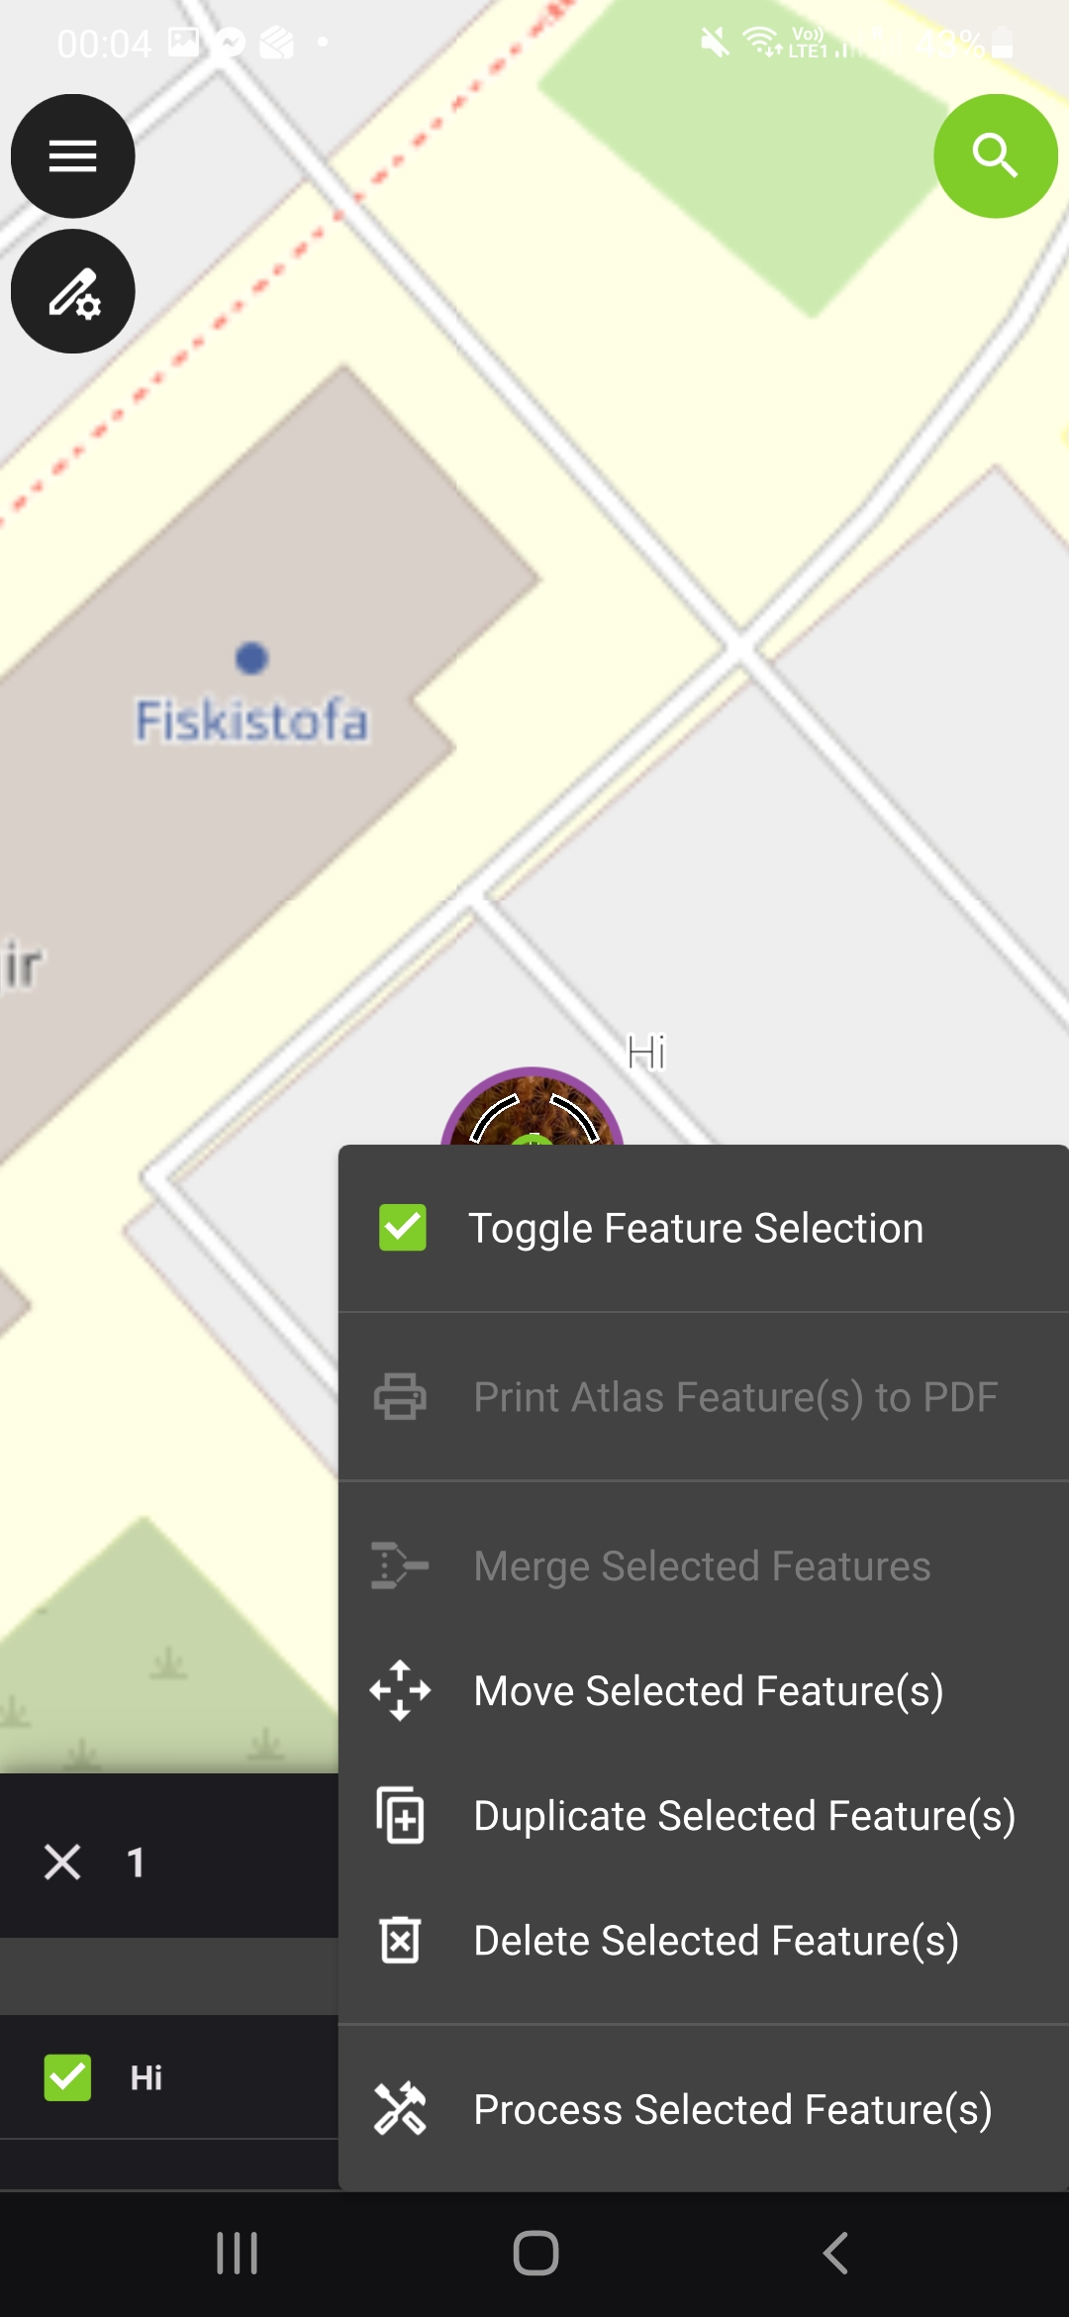
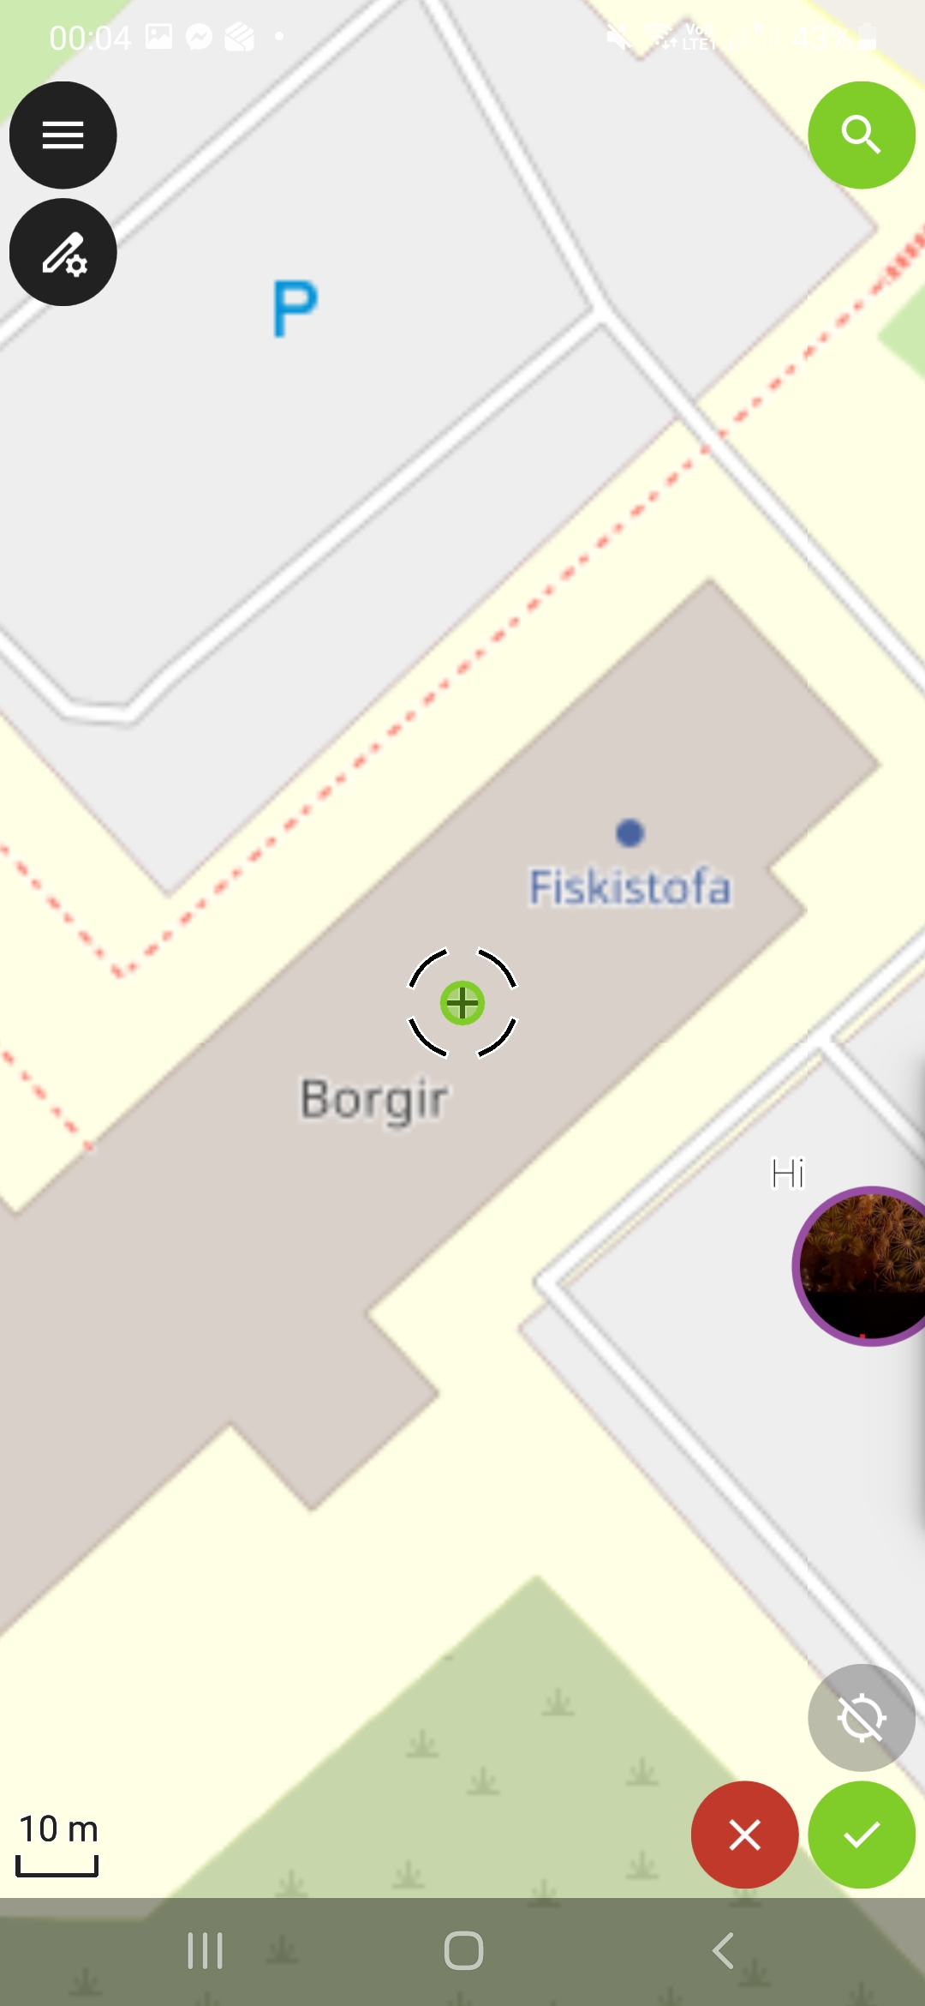
1
2

Slide 41
Rotate

Slide 42
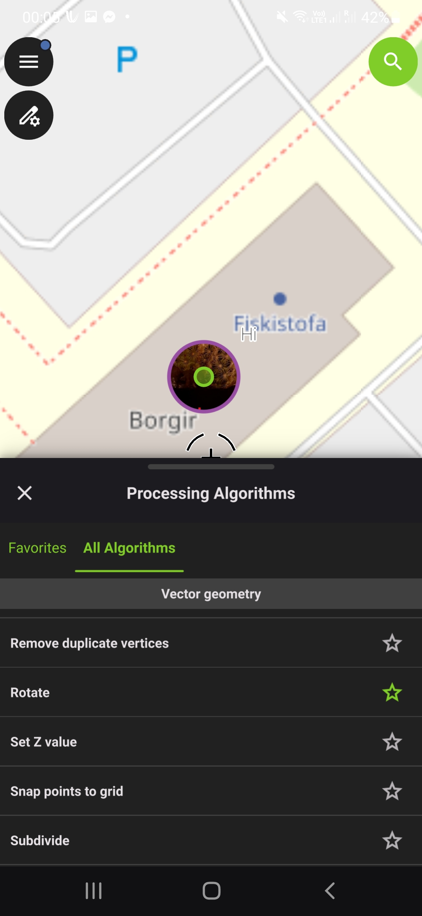
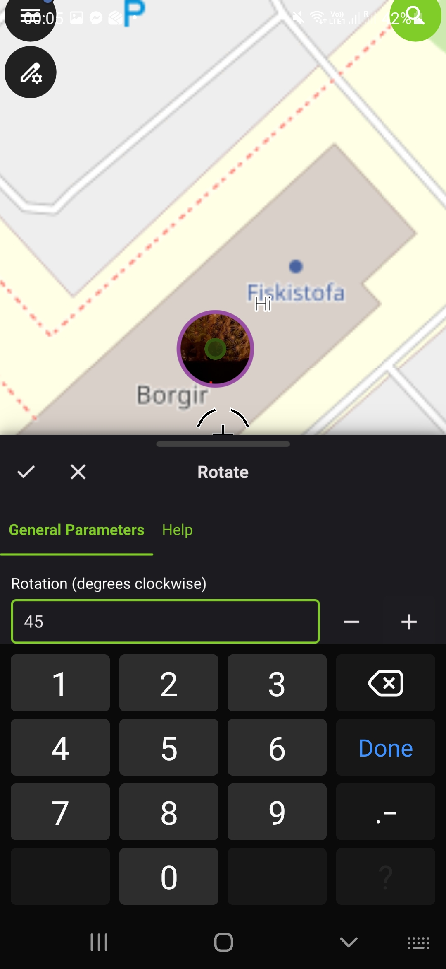
3
2
1

Slide 43
App Settings

Slide 44
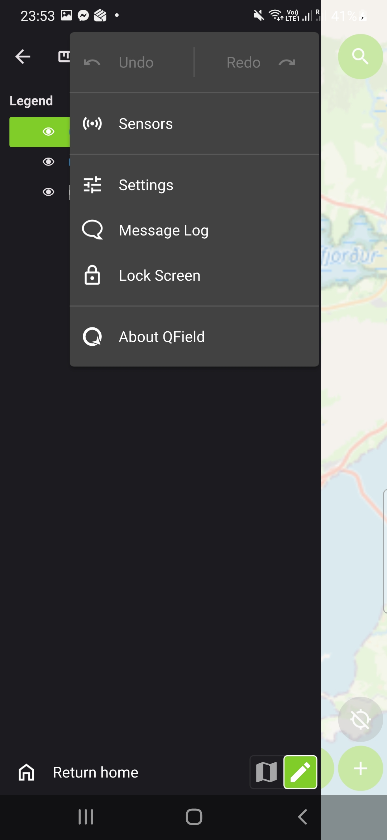
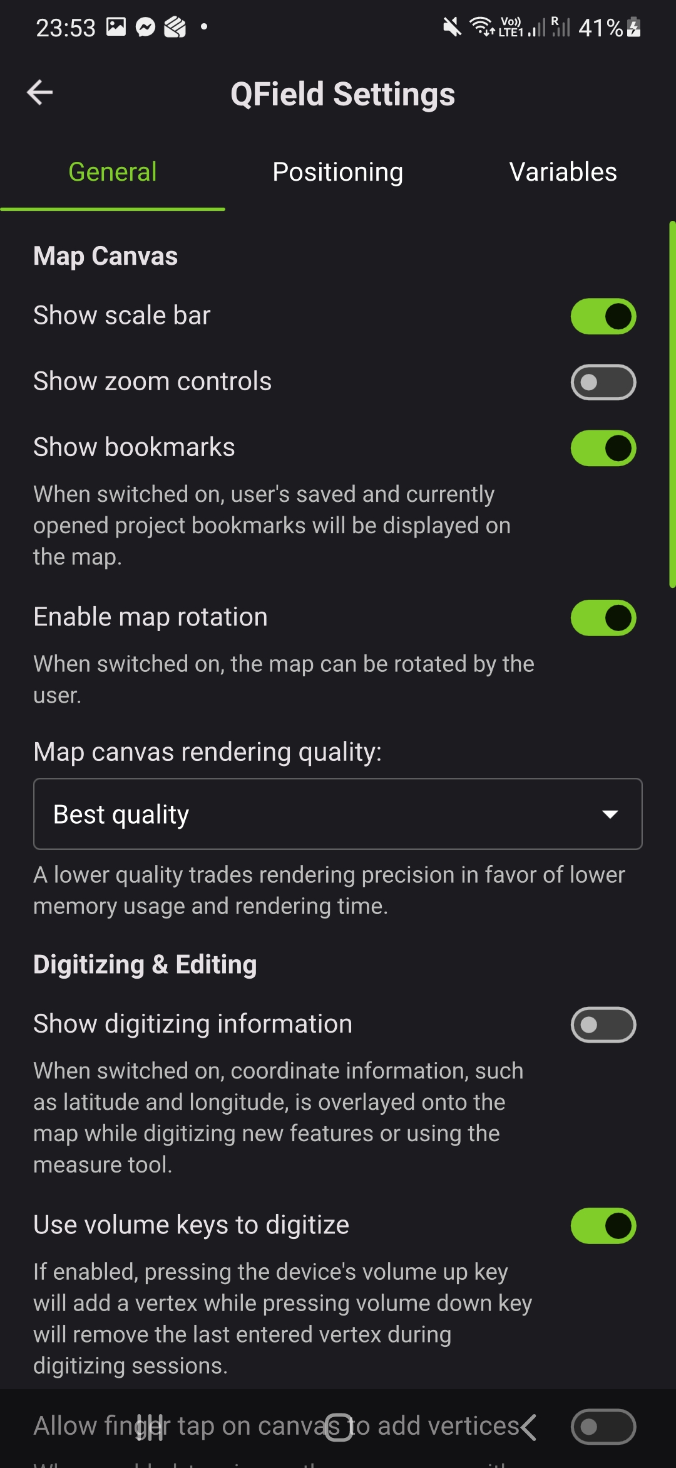

Slide 45
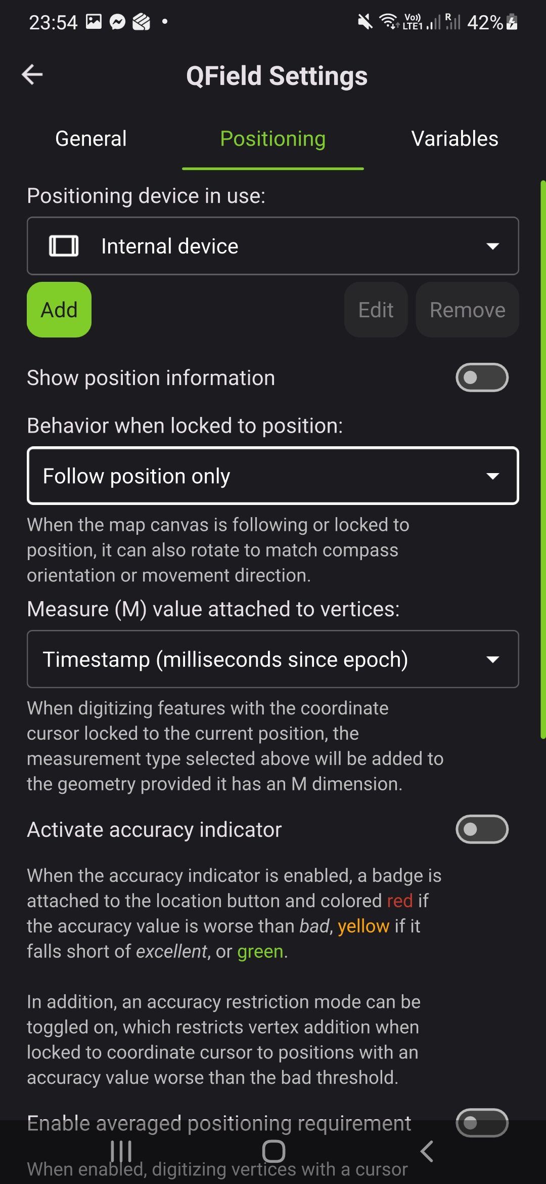
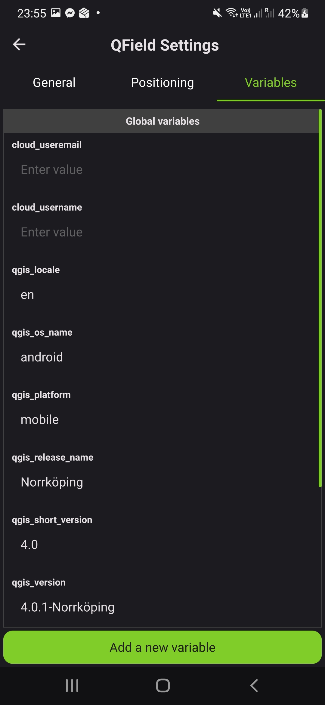

Slide 46
Export PDF

Slide 47
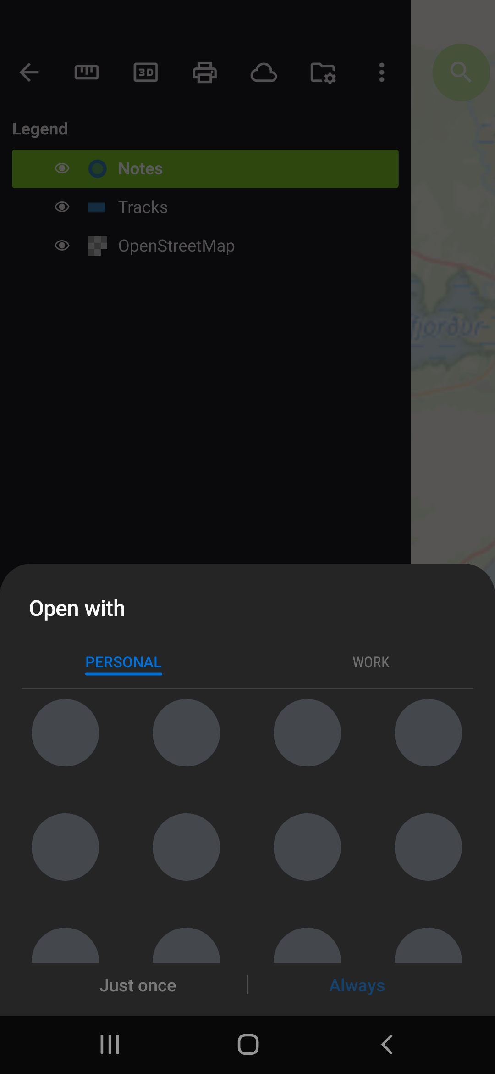

Slide 48
Local Files

Slide 49



Slide 50

Make it a cloud project
Requires Cloud Editor Permission – request if needed at qfield@natt.is

Slide 51



Slide 52


Cloud Exercise Start
You need a QField Cloud account from Náttúrufræðistofnun from here on.
If you do not have request one at qfield@natt.is

Slide 53

Login

Slide 54




Slide 55



2x
REQUEST account qfield@natt.is

Slide 56

Open Project
→ utivist_NATT

Slide 57




Slide 58



1
3
2

Slide 59
Add Point

Slide 60




Slide 61
Take Picture and draw

Slide 62



3
2
2
1
1

Slide 63
Add Polygon

Slide 64


1
2

Slide 65



1
2
1
2

Slide 66
Edit Polygon

Slide 67



1
2

Slide 68


1
2

Slide 69
Rotate Polygon

Slide 70


1
1
2
2

Slide 71
Move Polygon

Slide 72

1
1
2
2

Slide 73

Push Changes

Slide 74



If you want to see changes from others

Slide 75


Thank you for the patience
Have fun mapping!

